Slide 1
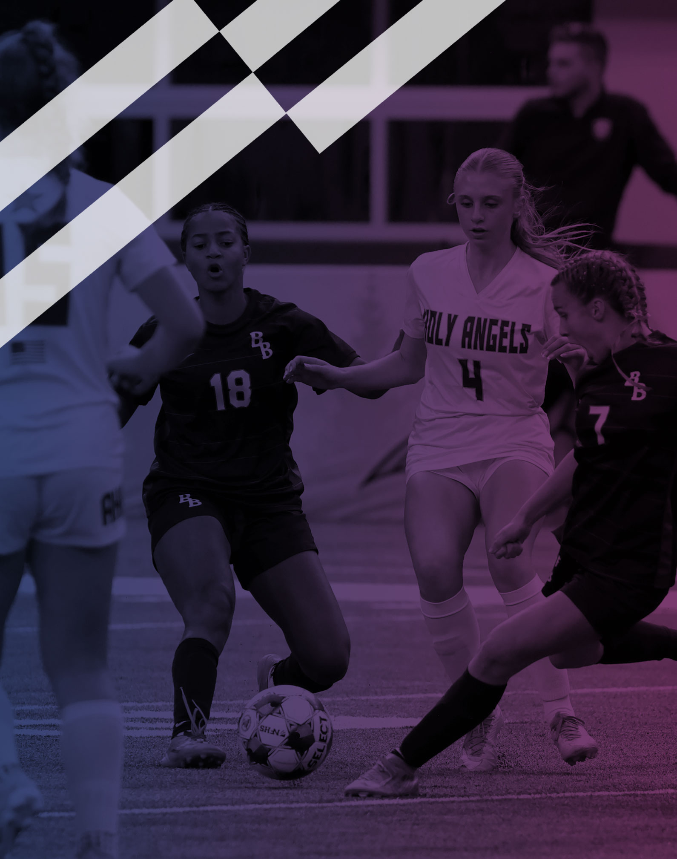
2026-27 NFHS Soccer PowerPoint

Slide 2
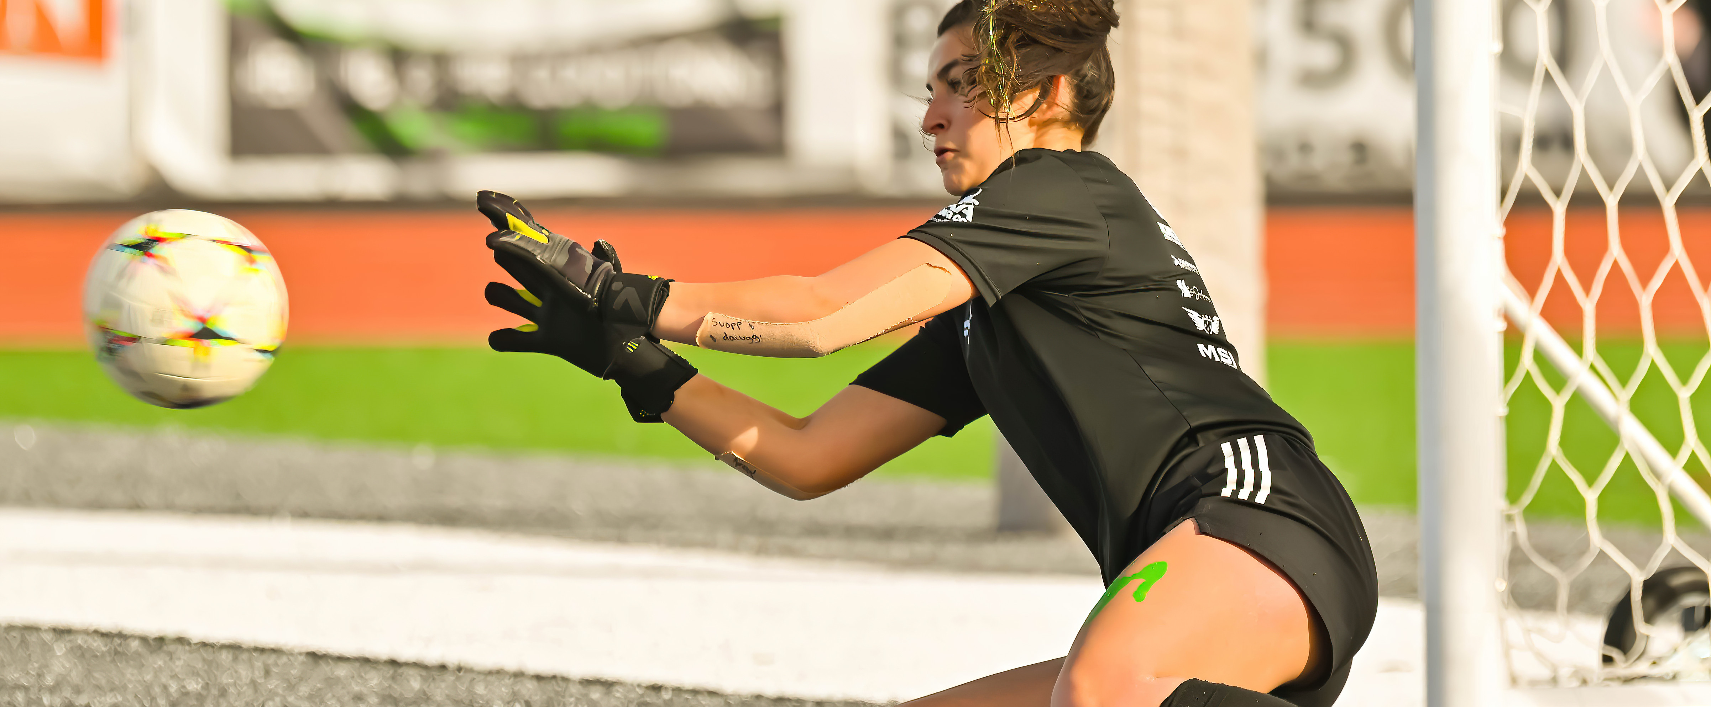
NFHS Information

Slide 3
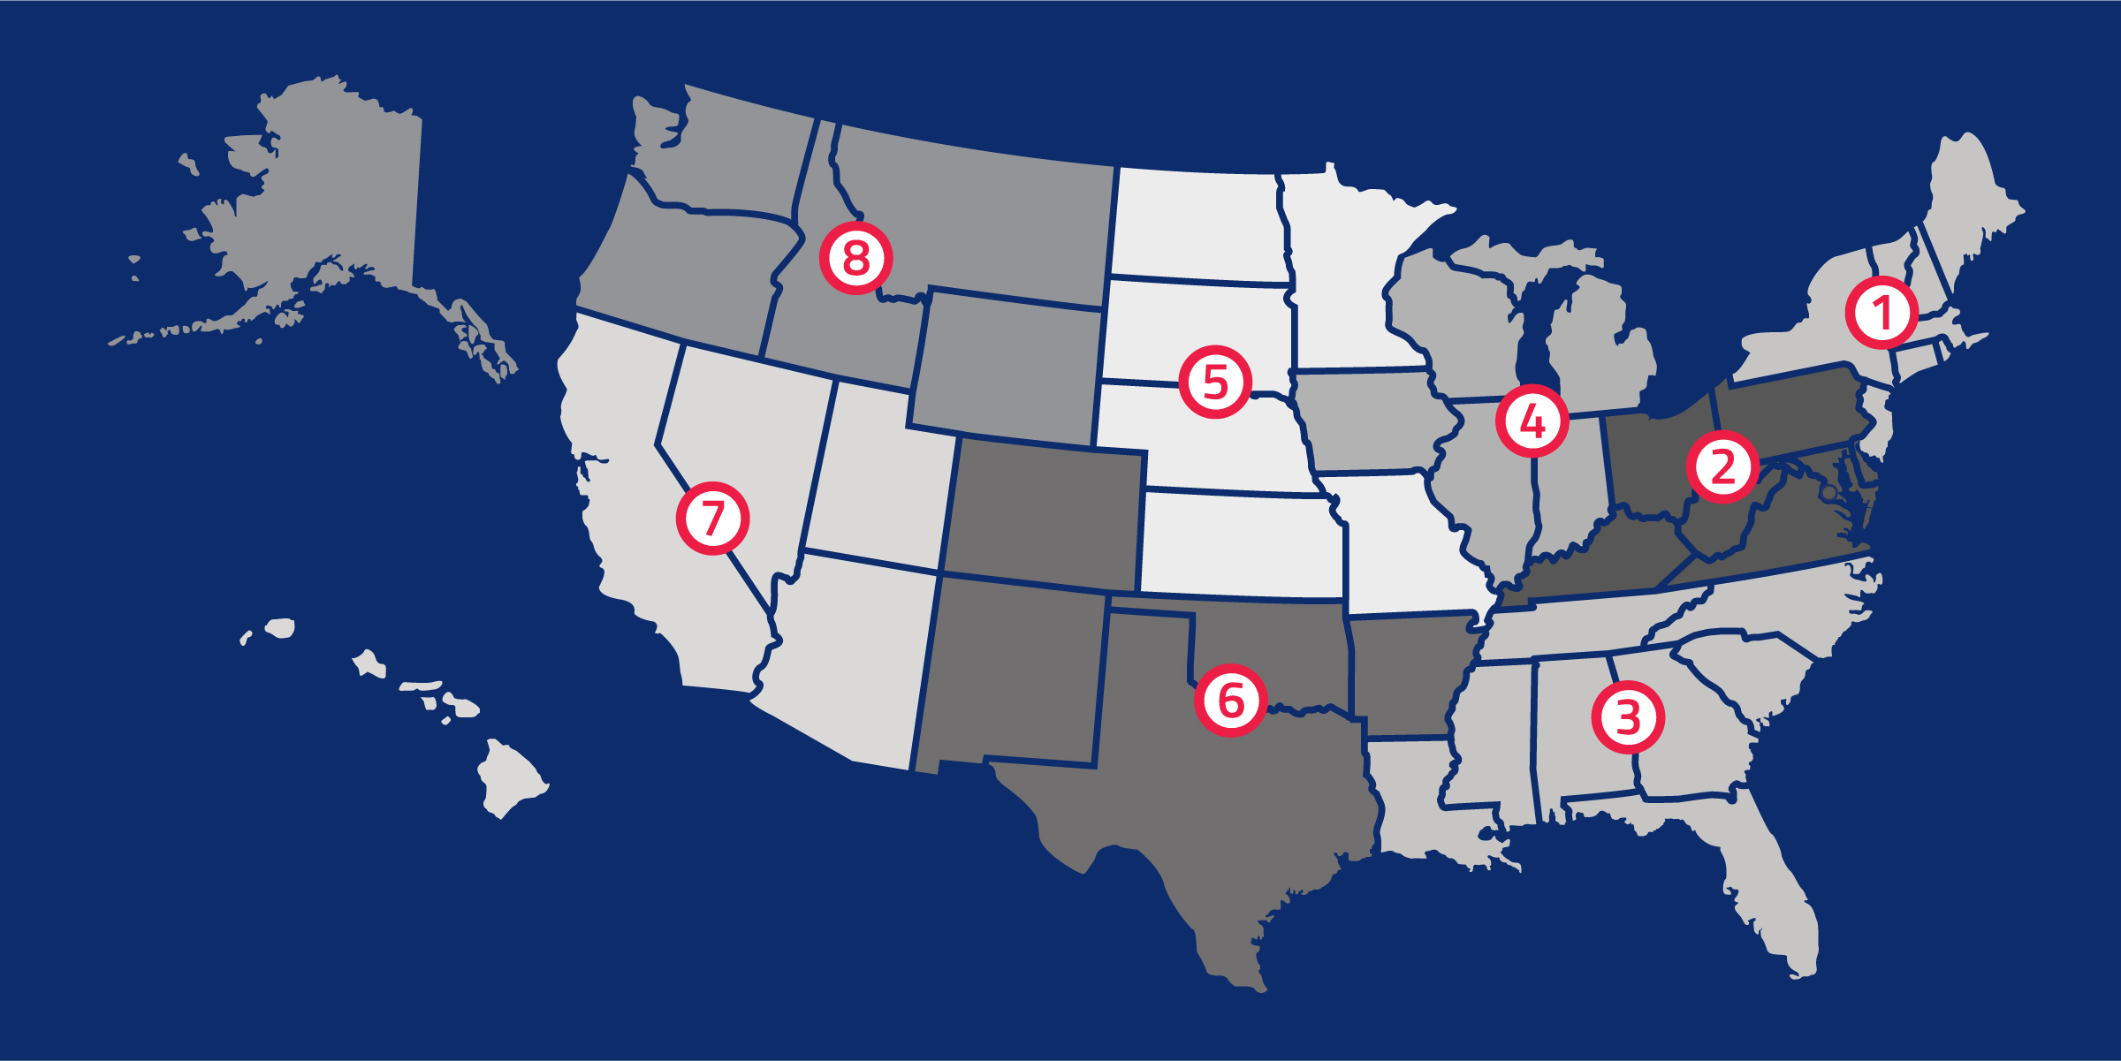
NFHS
NFHS (located in Indianapolis, IN – Est. 1920):
  National leader and advocate for high school
  athletics and performing arts programs.
  Serves 51 state associations, 19,983 high
  schools and 12 million student participants.
  Writes playing rules for 18 high school
  sports for boys and girls.
  Offers online education courses for high
  school coaches, officials, parents, students and others.
  Ensures that students have opportunity to enjoy healthy participation, achievement and good sportsmanship in education-based activities.
Notes:
The NFHS is the national leader and advocate for high school athletics and performing arts programs. Services of the NFHS reach more than 19,500 high schools and 12 million participants throughout the eight NFHS sections across the U.S.
A significant responsibility of the NFHS is the commitment to writing quality playing rules for 17 high school sports for boys and girls, in addition to providing educational resources for high school coaches, officials, parents and students.
It is the vision of the NFHS to help prepare tomorrow’s leaders for the next level of life through the many program offerings in education-based athletics and activities.

Slide 4

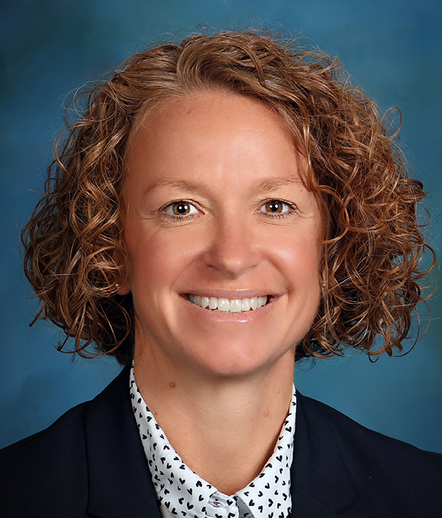
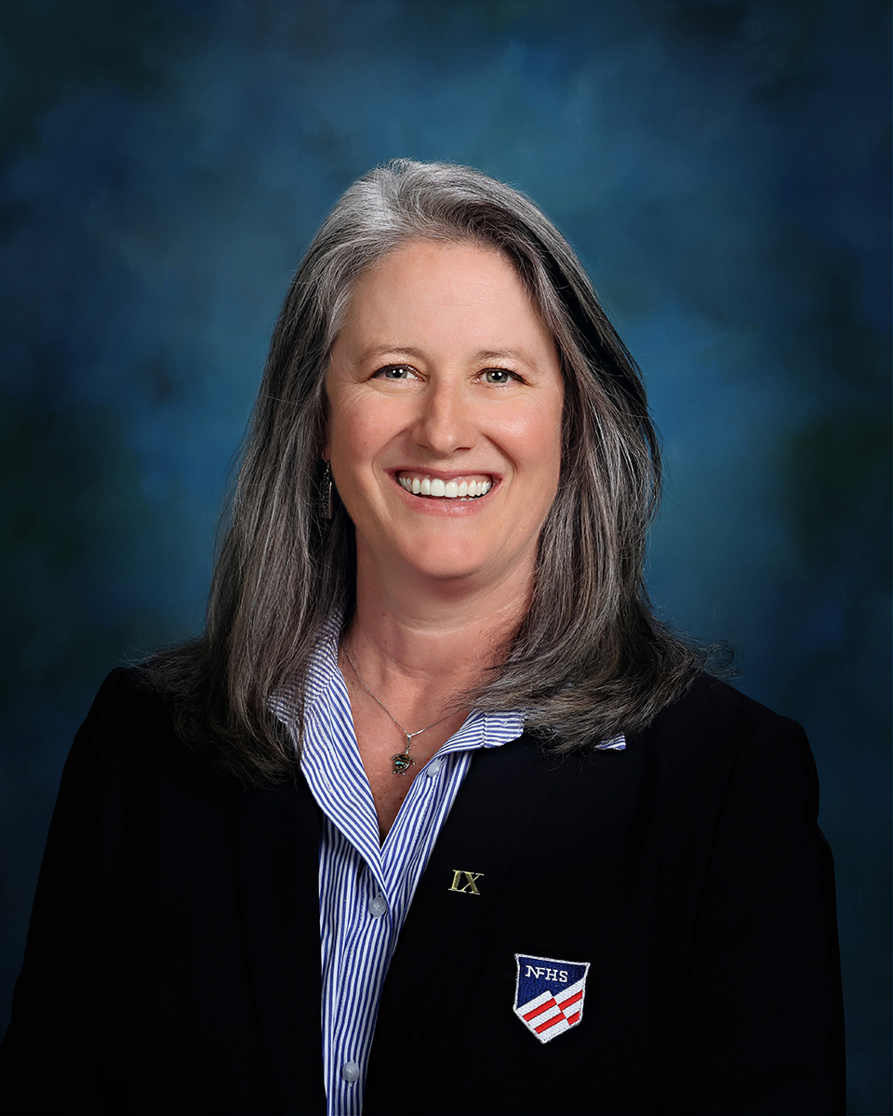


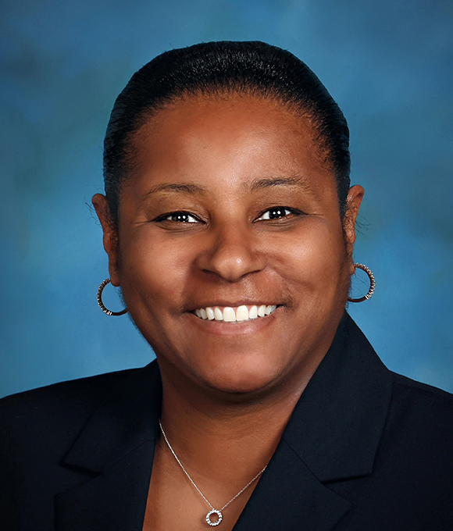

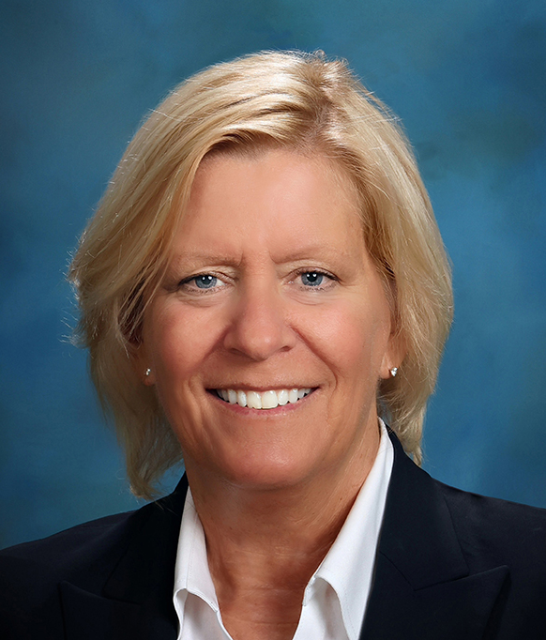

NFHS Rules Review Committee
The NFHS Rules Review Committee is chaired by the chief operating officer and composed of all rules editors. After each committee concludes its deliberations and has adopted its recommended changes for the subsequent year, such revisions will be evaluated
by the Rules Review Committee.
Davis Whitfield
Chief Operating Officer
Lindsey Atkinson
Boys & Girls Lacrosse and Volleyball
Julie Cochran
Cross Country, Soccer and Track & Field
Bob Colgate
Flag Football, Football and Sports
Medicine
Elliot Hopkins
Baseball and Wrestling
Monica Maxwell
Basketball, Field Hockey and Girls Gymnastics
Dan Schuster
Ice Hockey
Sandy Searcy
Softball, Swimming & Diving and Water Polo
Chris Paulson
Spirit
Notes:
The rules writing process is multi-tiered. Each year, specific committee meets to deliberate rules proposals submitted by state associations and committee members. After each committee concludes its deliberations and has adopted its recommended changes for the subsequent year, proposals are sent to the Rules Review Committee, who then evaluates the proposals and then forwards the to the NFHS Board of Directors for their consideration. The NFHS Rules Review Committee is chaired by the chief operating officer and consists of all NFHS rules editors

Slide 5


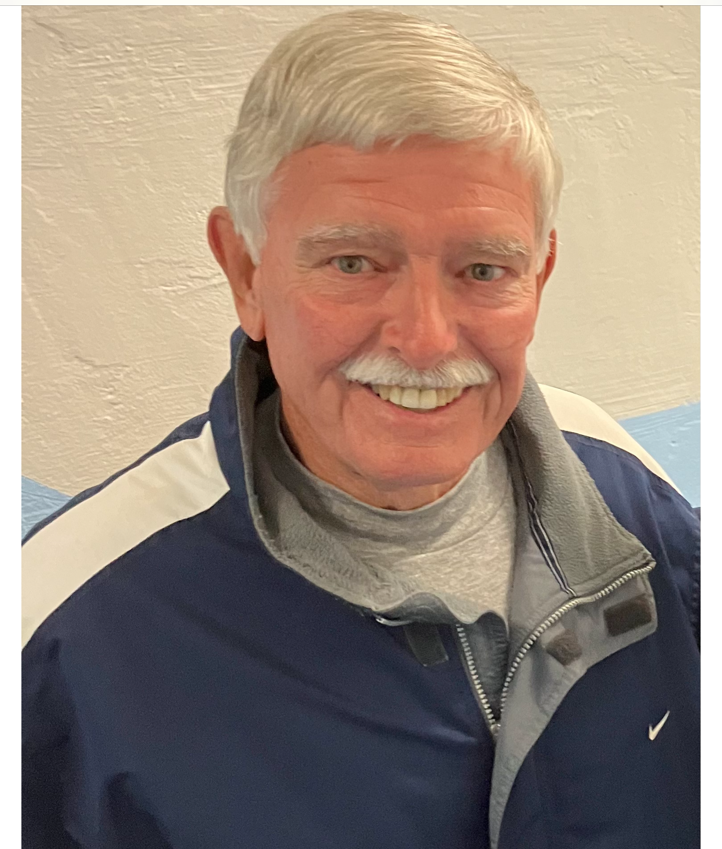

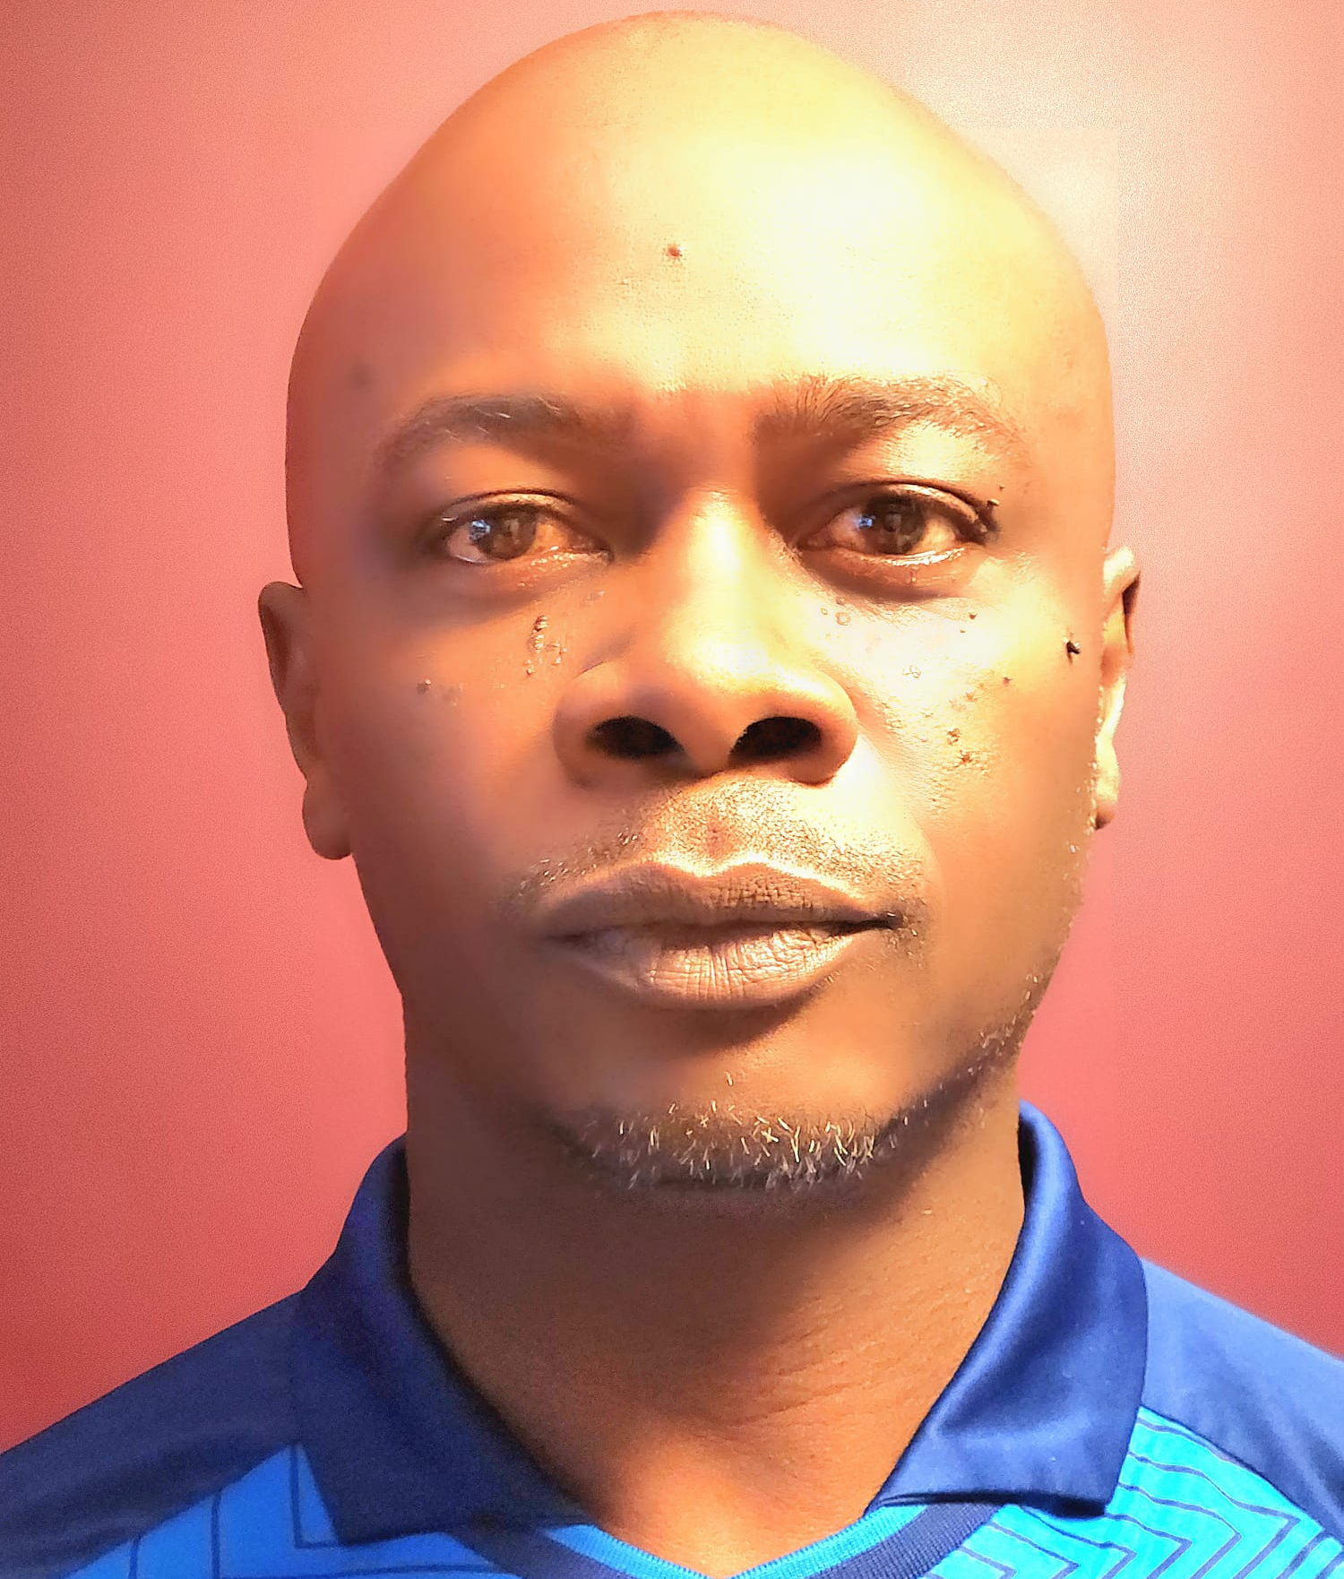

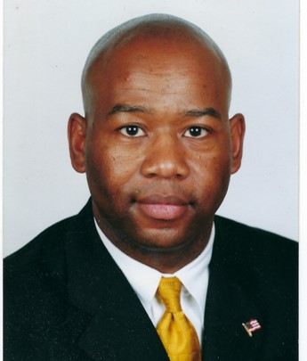





NFHS Rules Committee
Gibby Reynolds
OR
Chair - 2027
Julie Cochran
NFHS
Editor
Brianna Hines
VA
Coaches - 2026
Teri Connor
NJ
Officials - 2027
Bob Cavanagh
RI
Section 1 - 2028
Marianne Shultz
MD
Section 2 - 2026
Mohan Telfer
MD
Section 2 - 2028
Michael Federico
LA
Section 3 - 2029
Roger Morton
NC
Section 3 - 2027
Beth Sauser
IL
Section 4 - 2026
Steven Clark
MN
Section 5 - 2029
David Dancler
SD
Section 5 - 2029
Zac Stevenson
NM
Section 6 - 2028
Joe Oberndorfer
NV
Section 7 - 2027
Sandi Wagner
AK
Section 8 - 2029
Notes:
The 2025-26 Soccer rules committee members. Representation of eight sections, the NFHS Officials Association, the NFHS Coaches Association, and Rules Committee Chair. The Committee is chaired by Gibby Reynolds from the Oregon High School Activities Association.

Slide 6


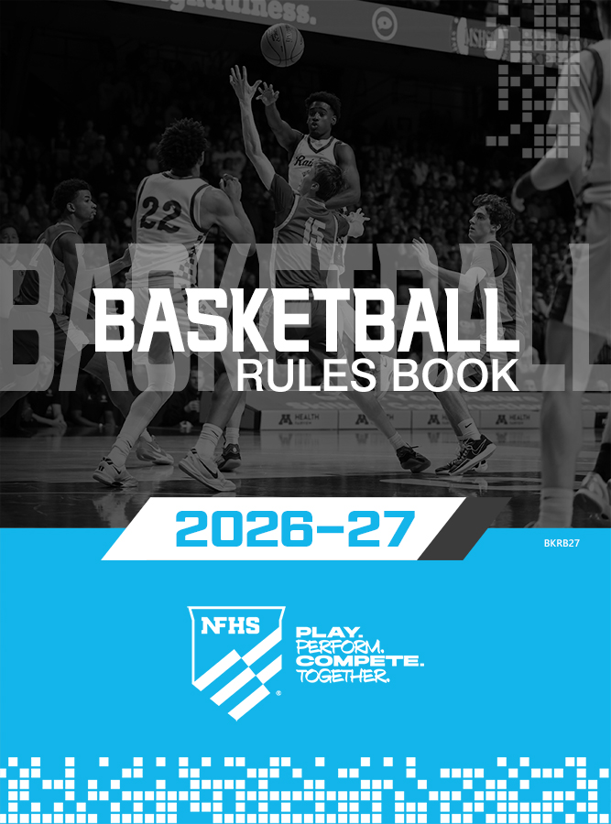


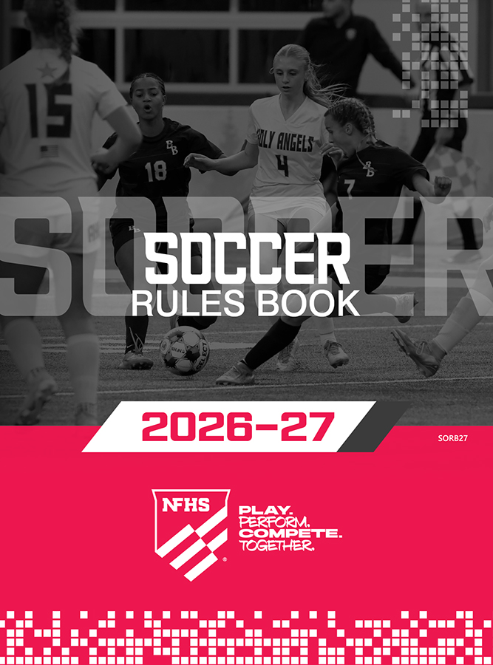

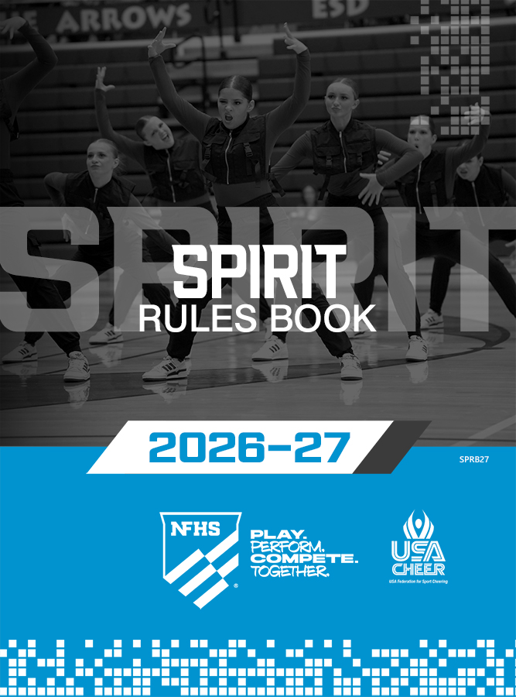




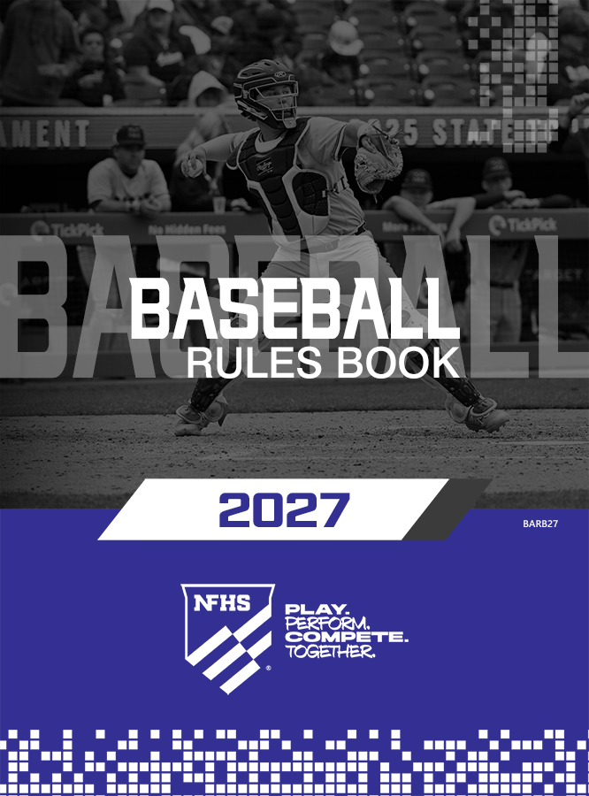
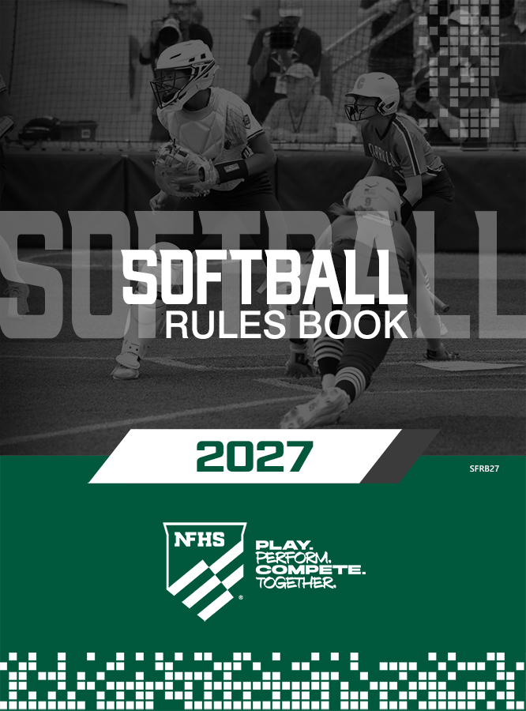
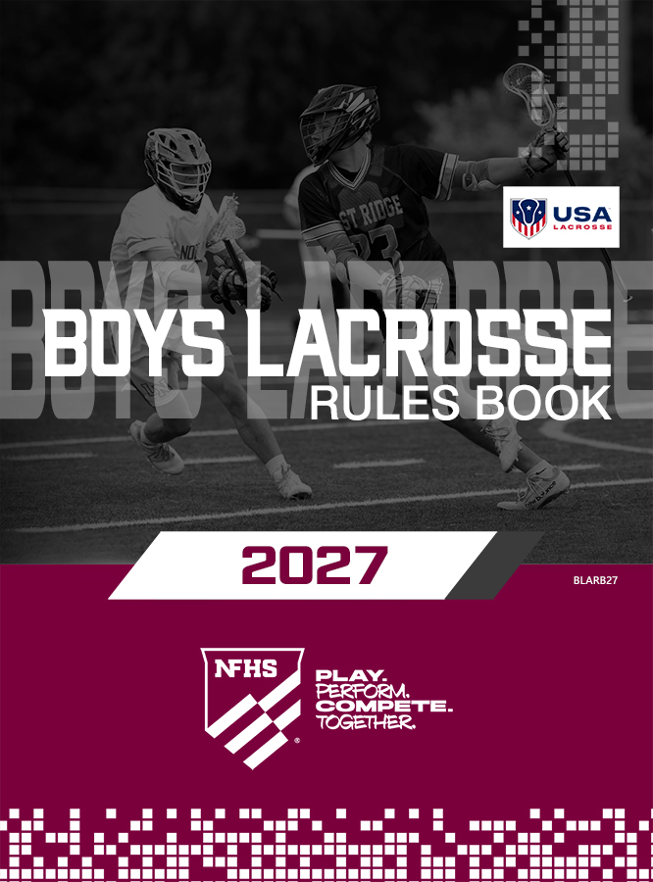



NFHS Publications
The NFHS writes playing rules for 18 sports
for boys and girls at the high school level.
  Publishes 2 million pieces of materials annually.
Notes:
The NFHS writes playing rules for 18 sports for boys and girls at the high school level and publishes 4 million pieces of materials annually. Flag Football is the newest addition to this group.

Slide 7

NFHS Digital
NFHS Digital is the digital publications platform for the NFHS. The app includes:
  Rules Books
  Case Books
  Officials Manuals
  Preseason Guide
  Policy Debate Quarterly
  Other NFHS Publications

Slide 8

NFHS Digital – Mobile App
NFHS Digital is available via mobile app (on App Store or Google Play) or as a desktop platform.
Features include:
  View publications for sale in the NFHS Digital Store
  View publications assigned to/purchased by you
  Create comments, save notes, and share!
  Highlight content to review later
  Visit https://nfhs.org/about/nfhs-digital

Slide 9
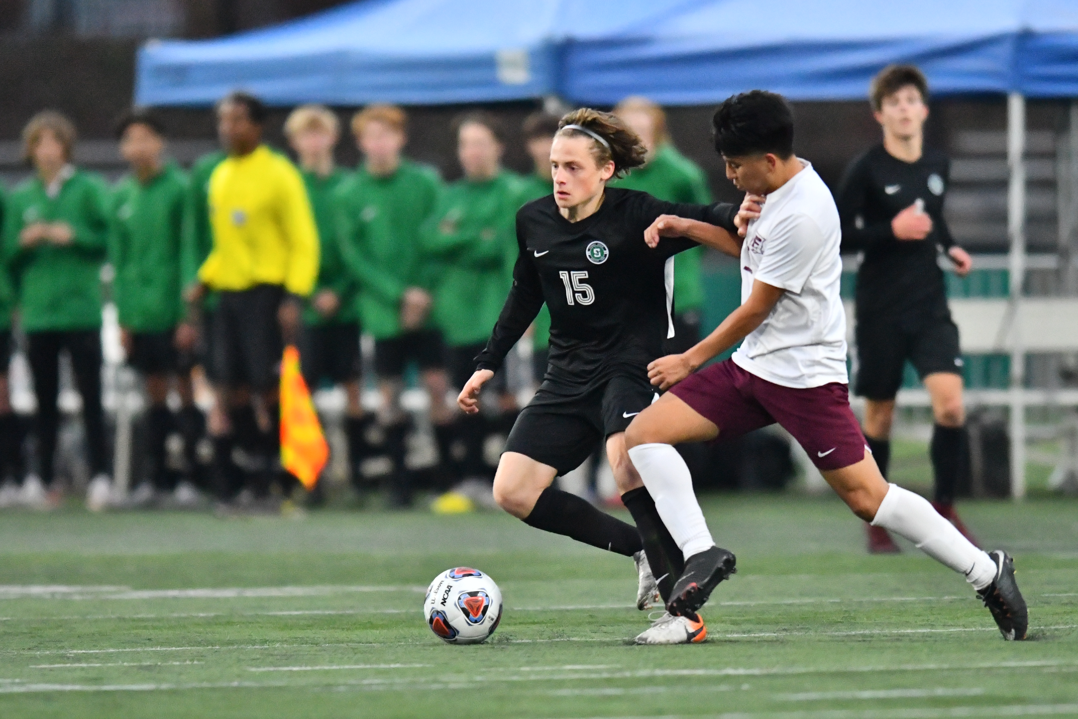
2026-27 NFHS Soccer Rules Changes

Slide 10
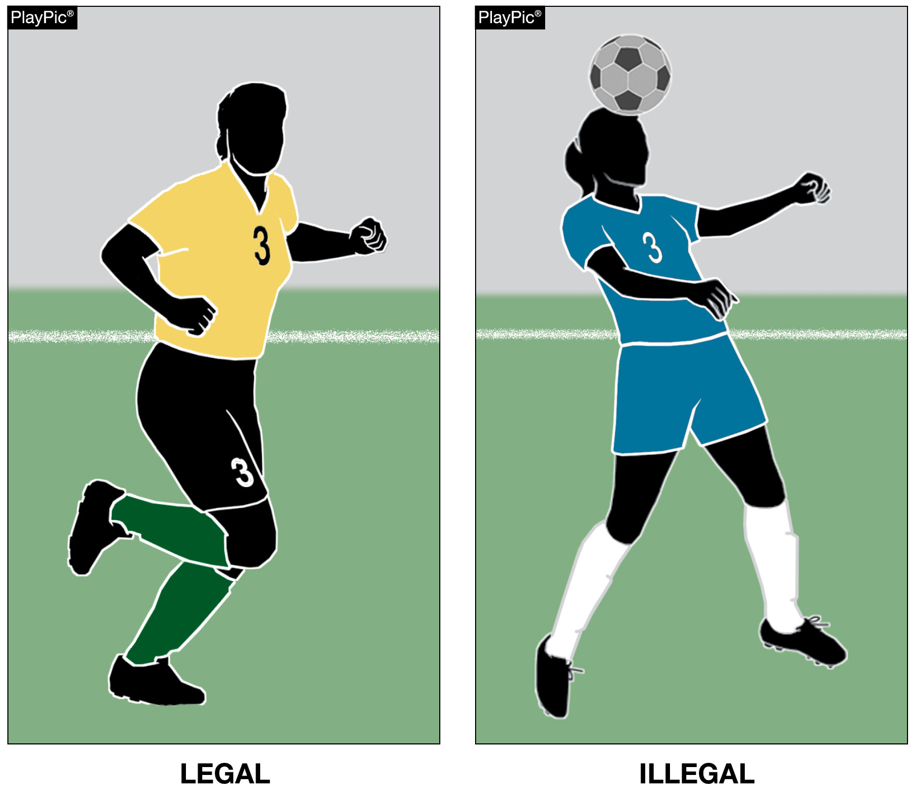
REQUIRED UNIFORM
RULE 4-1-4c
Home team socks shall be a single dominant dark color, but not necessarily the color of the jersey for the home team. Dark is defined as any color which contrasts to white.
Notes:
Rationale:
The two teams must wear colors that distinguish them from each other. The addition of the word dark in the home team sock clarifies that only the visiting team may wear white socks. This has been the current interpretation for years.

Slide 11
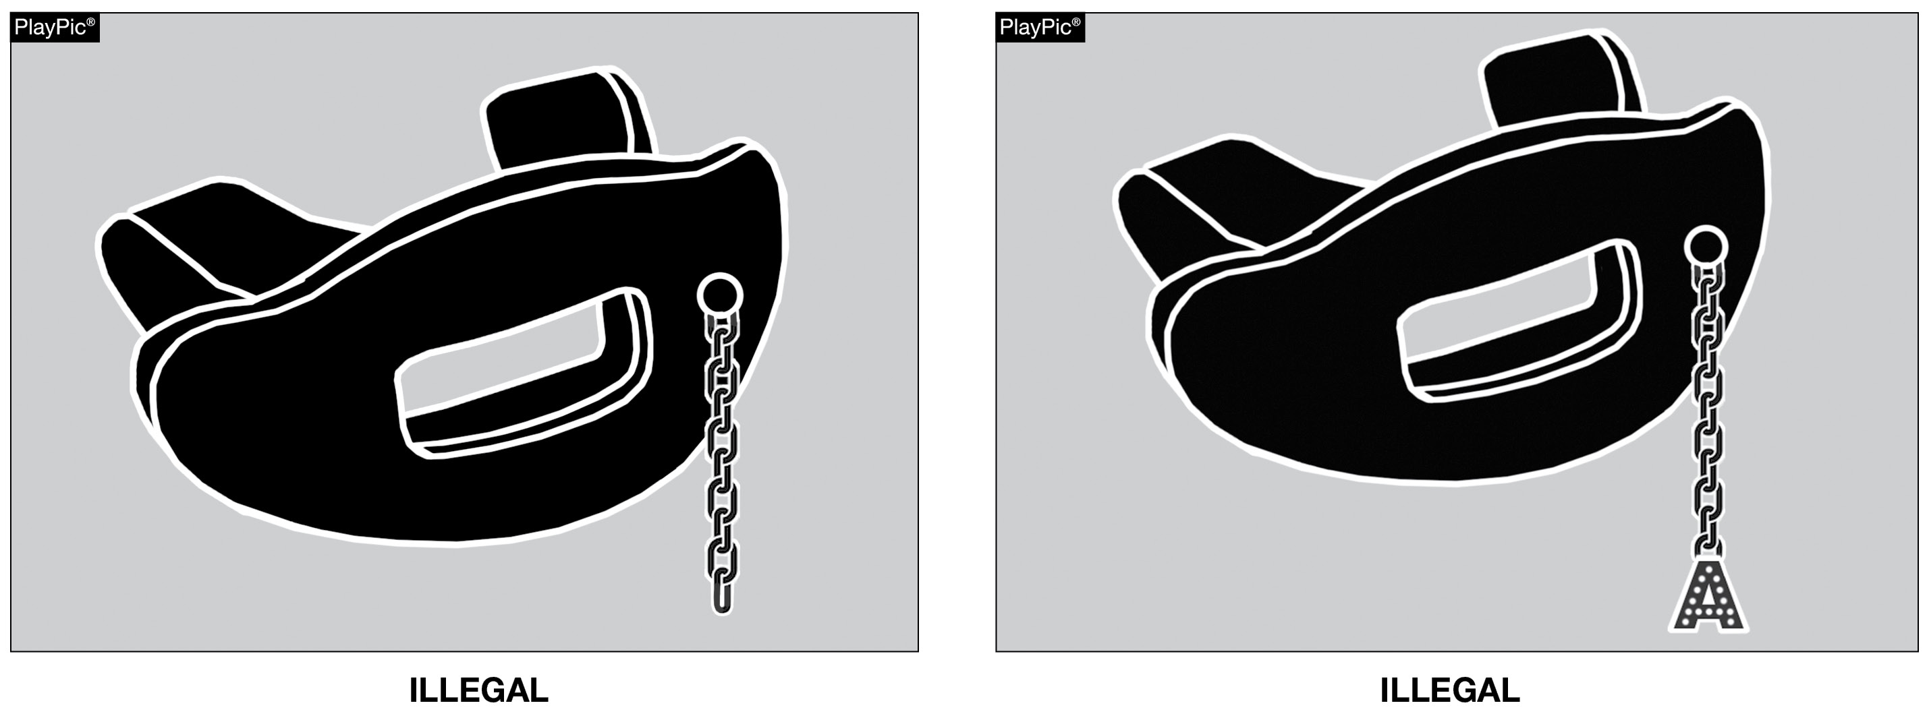
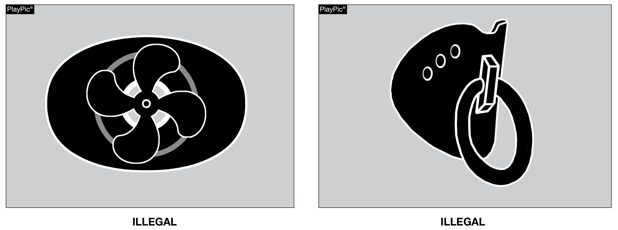
TOOTH & MOUTH PROTECTOR
RULE 4-2-7d
Tooth and mouth protectors, if worn by players, should not serve any function other than to protect the teeth or mouth.
Notes:
Rationale:
The overall purpose and function of the tooth and mouth protector is to protect the teeth, the mouth, and lips if it has a lip guard. Items that are added or included on the tooth and mouth protector that do not serve a purpose or function in the protection of the teeth or mouth should not be allowed. Also, items that are a part of the tooth and mouth protector that are a health risk to the individual wearing it should not be allowed.

Slide 12
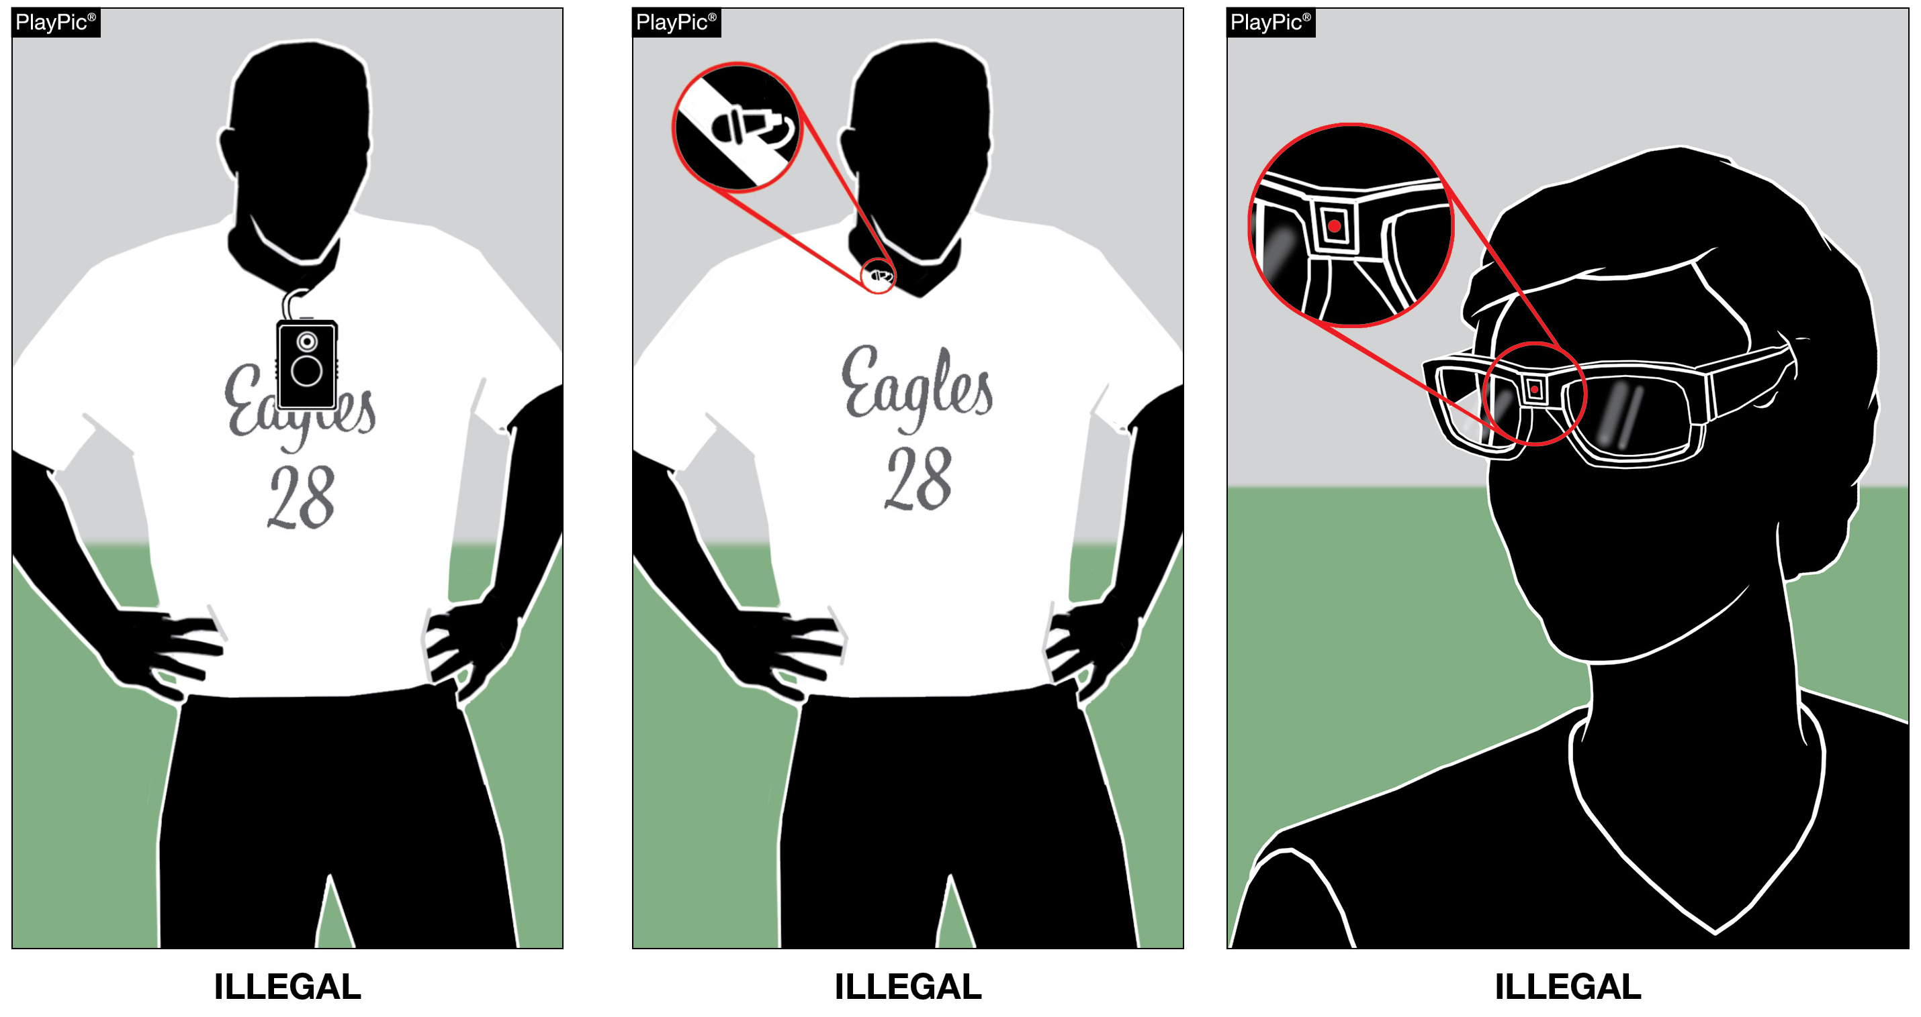
WEARABLE TECHNOLOGY
RULE 4-2-11a thru c
Players are not permitted to wear any type of audio or video device to record, transmit or livestream, aligning with other NFHS rules books.
State associations may further restrict electronic devices.
Notes:
Rationale:
No player participating in a match is permitted to wear any type of audio or video device to record, transmit, or live stream. This language aligns with other NFHS rules books. The use of electronic communication devices with players on the field is still prohibited. State associations may further restrict electronic devices.

Slide 13
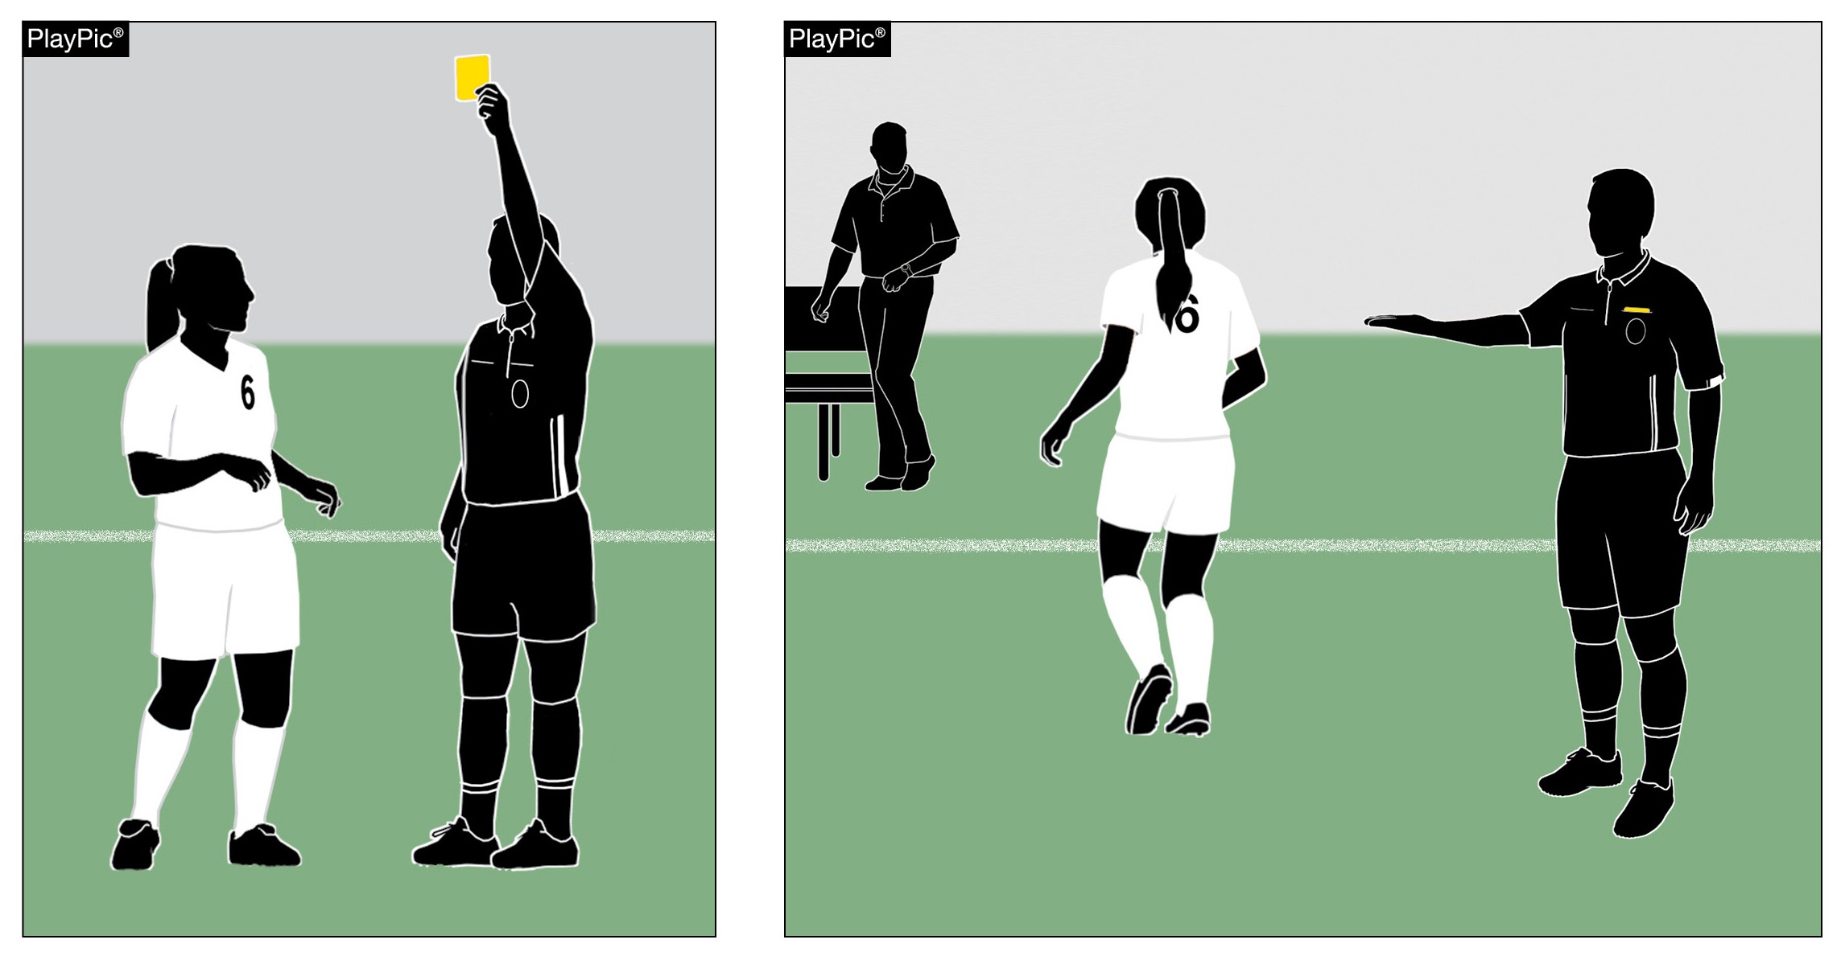
THE OFFICIALS
RULE 5-3-1f thru j
Added clarification in Rule 5, for the officials' responsibilities to now include directing any player shown a yellow or red card to leave the field of play.
The official must notify both coaches, the scorer, and other official(s) of the nature of the misconduct after showing a yellow or red card to a player, coach or bench personnel.
Notes:
Rationale:
This aligns terminology by removing the term “carded” and using language found within the rules book. Explicitly defining that cautions correspond to yellow cards and ejections correspond to red cards provide clarity. Repeated or redundant language has been reorganized into new sub‑articles to improve readability and consistency across the rule. Additionally, the revision clarifies that any player who is shown a card, yellow or red, must still leave the field of play and that officials are responsible for directing the player to do so.

Slide 14
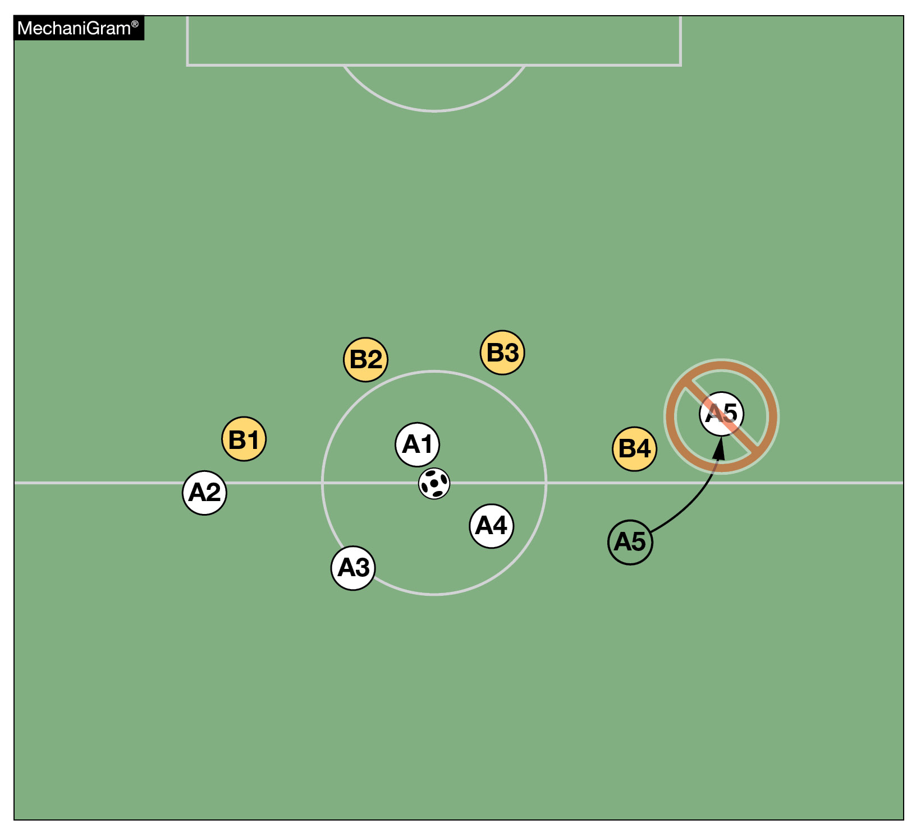
KICKOFF
RULE 8-1-2
All players, except the player taking the kickoff, must be on their half of the field otherwise the kickoff shall be retaken.
Notes:
Rationale:
This change provides clarity on the differing restarts regarding kickoff offenses. This change explicitly addresses situations when the kickoff should be retaken because players were not properly positioned on their half of the field.
An indirect free kick is awarded to the opponent if the offensive player who took the kickoff touches the ball after the kick before it is played or touched by another player on either team

Slide 15
BITING
RULE 12-2-3
Biting was incorporated into direct free kick fouls.
A player shall not spit at or bite anyone listed on a roster or a game official, otherwise a direct free kick foul will be awarded.
Notes:
Rationale: Incorporates biting into direct free kick fouls.
The old rule only discussed spitting at a player the new rule incorporates spitting or biting essentially anyone.

Slide 16
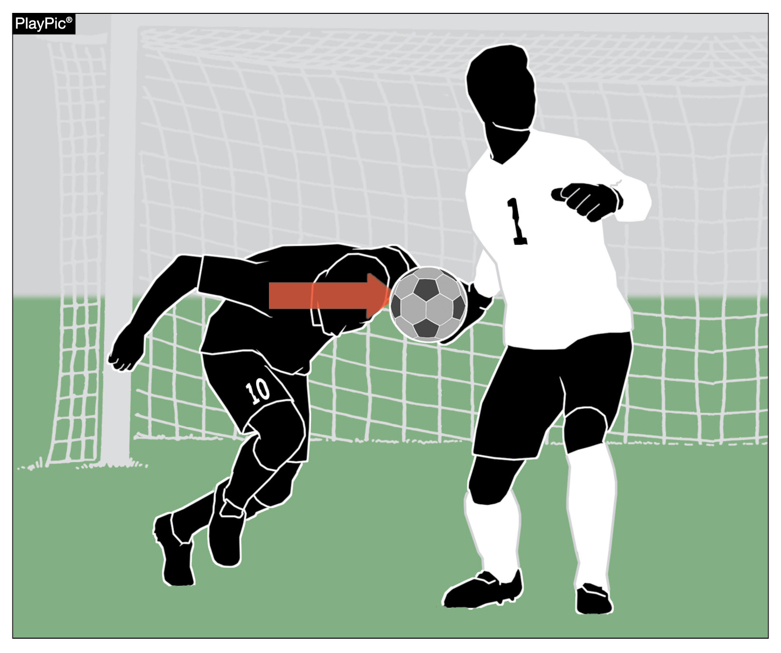
FOULS AND MISCONDUCT
RULE 12-1-2c
A player shall not charge into, or challenge, an opposing goalkeeper who is controlling the ball with their hands.
Penalty: Direct Free Kick
Outside the penalty area, the goalkeeper has no more privileges than any other player.
Notes:
An attacker trying to head the ball out of the opposing goalkeeper’s hand commits a direct free kick foul.
Rationale:
Overall, this change aligns the rule with consistent officiating practice, removes redundancies and improves clarity without materially altering when a charge is or is not permitted. The change consolidates language referring to the goalkeeper controlling the ball with their hands, where the simplified language refers to the full, shared definition referenced in a later section. This change emphasizes the core safety concept that remains unchanged: the goalkeeper in possession of the ball with their hands cannot be charged or challenged.

Slide 17
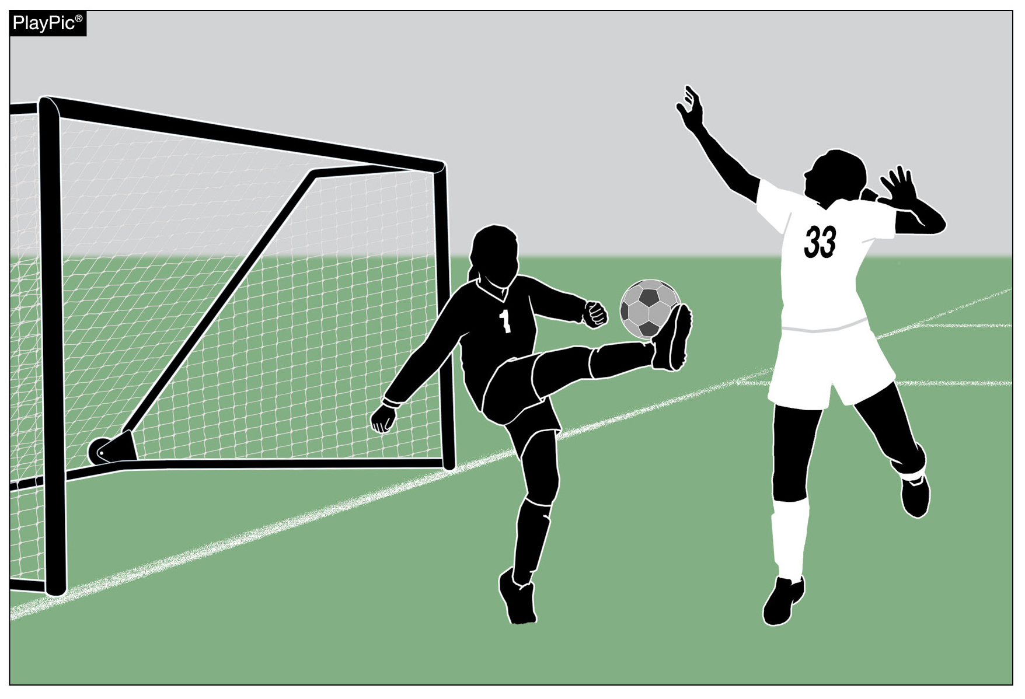
GOALKEEPER INTERFERENCE
RULE 12-3-2
Goalkeeper Interference: A player shall not prevent the opposing goalkeeper from releasing the ball from their hands nor kick, or attempt to kick, the ball when the goalkeeper is in the process of releasing it.
Penalty: Indirect Free Kick
Notes:
The attacker jumping at the goalkeeper preventing them from releasing the ball without making contact commits an indirect free kick (IDK).
Rationale: We reworded this rule to make it clearer to coaches and officials to distinguish the difference between charging a goalkeeper in possession of the ball vs. interfering with the goalkeeper releasing the ball.

Slide 18
RULE 12-3-2a
The goalkeeper is considered to be in control of the ball with the hand(s)/arm(s) when:
The ball is between the hands or between the hand and any surface (e.g., ground, own body, goal post) or by touching the ball with any part of the hands or arms;
Holding the ball in an outstretched open hand;
Bouncing the ball on the ground or throwing the ball in the air, including bouncing or throwing the ball as part of kicking or punting the ball.
Notes:
12-3-2b: When the goalkeepers puts the ball on the ground, they relinquish their privileges as goalkeepers.
Rationale: This comprehensive language was combined from separate articles in rule 12 into one article. It also clearly defines what it means for a goalkeeper to posses the ball.

Slide 19
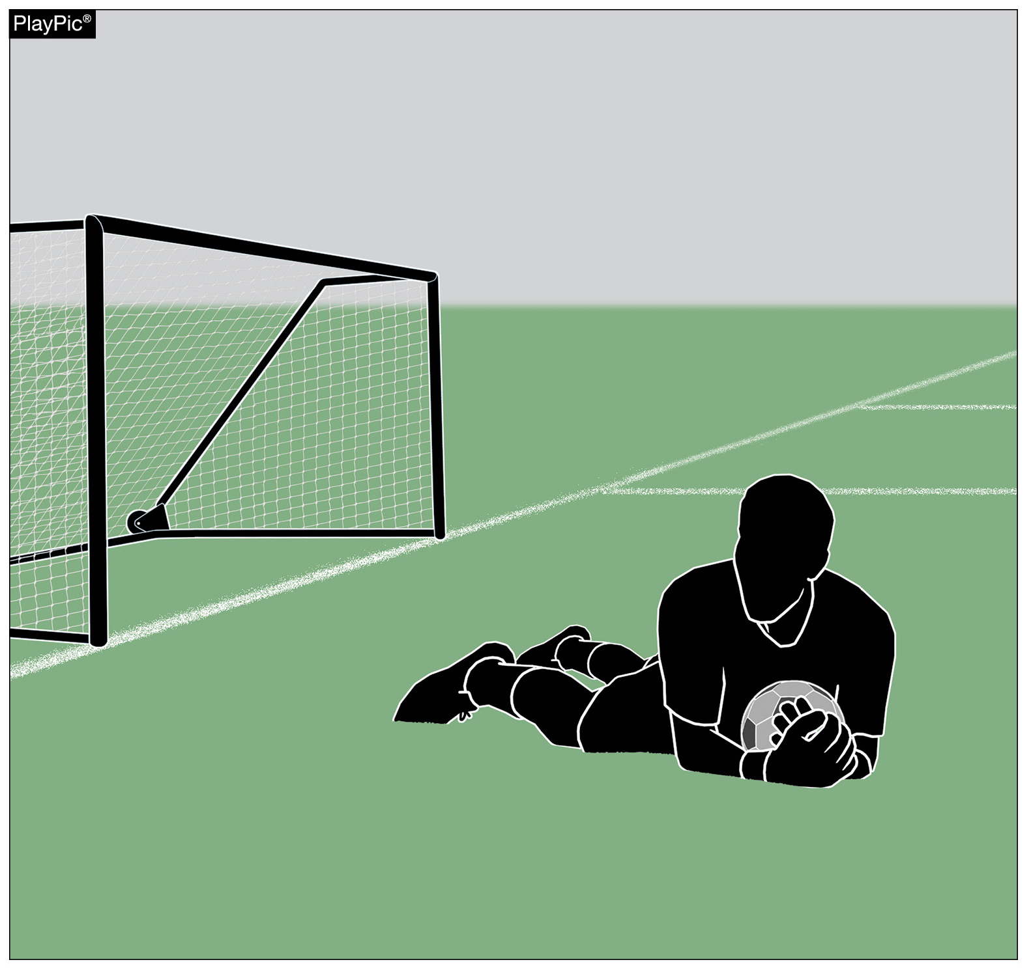
GOALKEEPER
RULES 12-3-1, 12-3-3a and 17-1-1, 3
After controlling the ball with their hands/arm, the goalkeepers will now have 8 seconds instead of 6 seconds to release the ball.
The referee determines when the 8 second count begins.
Penalty: A corner kick will be awarded if the goalkeeper holds the ball longer than 8 seconds, replacing the previous indirect free kick restart.
Notes:
Rationale:
Reorganizes goalkeeper restrictions, extends goalkeeper possession limit from six to eight seconds and changes the penalty from indirect free kick at the point of infraction to a corner kick.
The referee may start the 8 second count once the goalkeeper clearly has gained uncontested possession with their hands as shown in the PlayPic.

Slide 20
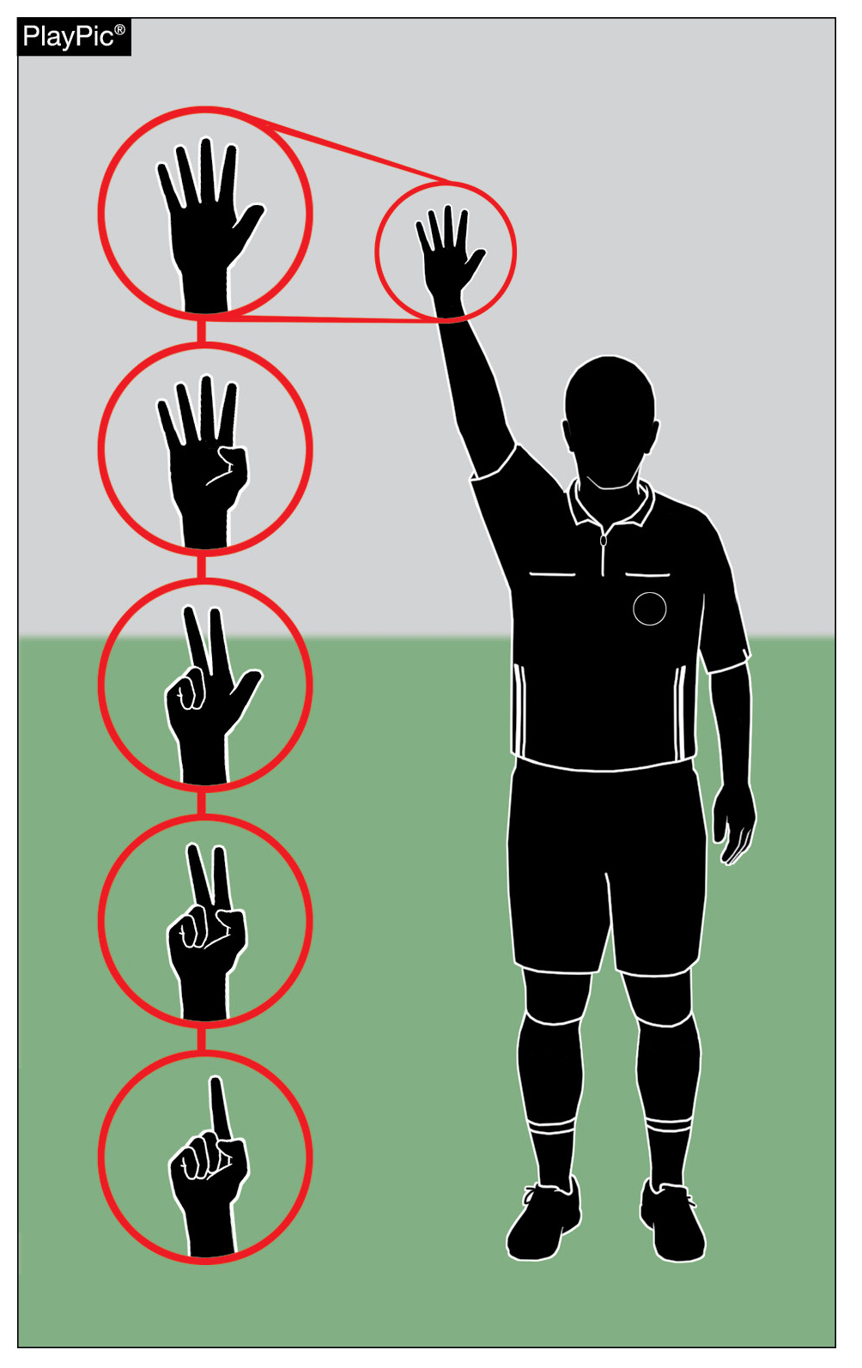
GOALKEEPER
RULES 12-3-3a(2)
The referee shall signal the remaining five seconds (using Official NFHS Soccer Signals, Rule 5-3-1b) by raising an arm above the head and indicating the number of seconds left with their fingers.
Violations of this rule are still enforced even if the referee fails to provide a visual signal.
Notes:
Rationale: Adds signal to the NFHS soccer Rule Signal Chart to help communicate the goalkeepers time remaining in the new 8 second restriction.

Slide 21
INDIRECT FREE KICKS
RULE 12-3-5
Clarifying language was added to considerations for dangerous play.
Dangerous play now explicitly includes actions preventing a nearby opponent from playing the ball for fear of injury.
This includes playing in such a manner which could cause injury to self or another player, opponent or teammate, or which prevents a nearby opponent from playing the ball for fear of injury.
Notes:
Rationale:
Adds clarifying language to the considerations for dangerous play that include actions that prevent a nearby opponent from playing the ball for fear of injury.

Slide 22
VERBAL OFFENSES
RULES 12-3-6, 12-3-7
Rules 12-3-6 was added to include verbal offenses as IDFK.
This gives officials more flexibility when disciplining verbal offenses: they are now considered fouls at a minimum and may rise to the level of misconduct depending on the circumstances.
Rule 12-3-7 Address if the game is stopped for misconduct and no other restart takes precedence; then it will restart with IDFK.
Notes:
Rationale:
Including verbal offenses as an indirect free kick foul, this also gives more flexibility for officials when disciplining verbal offenses: they are now considered fouls at a minimum and may rise to the level of misconduct depending on the circumstances.
New Article 7 then addresses any other reason for which play is stopped for misconduct; play is restarted with an indirect free kick.
Verbal offense situations
Situation: On a penalty kick, the defending team B2 shouts loudly at the moment that A10 is about to kick the ball. This is unfair interference and distracts the kicker. The referee retakes the penalty kick. RULING: Correct Procedure.
Situation: A2 is about to receive the ball, an B3 who is close and behind the defender, shouts to mislead the opponent. A2 hesitates and fails to control the ball turning it over to B3. The referee stops play and awards an indirect free kick (INDFK) and cautions B3 for unsporting behavior. RULING: Correct procedure. The referee may award an IDFK if they feel the verbal offense warrants the stoppage.

Slide 23
DOGSO EJECTIONS
RULE 12-6-1b (1-4)
Revisions clarify and simplify language surrounding Denying an Obvious Goal-Scoring Opportunity (DOGSO) ejections.
Redundant wording was removed and references to intending to deny a goal or goal-scoring opportunity (DOGSO) were eliminated.
The updated structure provides clear situations for which denying a goal or obvious goal-scoring opportunity is penalized with an ejection.
Notes:
Rationale:
This change clarifies and simplifies the language surrounding DOGSO ejections by removing redundant wording, references to intending to deny a goal or a goal-scoring opportunity were eliminated. Aligns with previous rule wording within Rule 12. The updated structure provides four clear situations for denying a goal or obvious opportunity resulting in an ejection.

Slide 24
FREE KICK RESTARTS
RULES 13-1 THRU 13-3
Revisions clarify procedures for restarts on free kicks by breaking the rule into distinct categories.
The update outlines when and where free kicks are awarded, how they are to be taken, and the correct restart locations.
It also incorporates restart procedures for scenarios involving outside agents, offenses off the field, thrown objects, individuals entering the field illegally, players leaving the field without permission, and offenses outside the field of play.
Notes:
Rationale:
The revision of Rule 13 clarifies the procedures for restarts on free kicks by breaking the rule into distinct categories, outlining when and where free kicks are awarded, and detailing how they should be taken. It also specifies the correct restart locations and provides guidance for officials on managing these situations. Additionally, the update incorporates restart procedures for scenarios involving outside agents, offenses occurring off the field, thrown objects, individuals entering the field illegally, players leaving the field without permission, and offenses that occur outside the field of play.

Slide 25
RULE 13-2
When and Where Awarded
Free Kicks are the restarts for fouls
Free Kicks are taken from where the offense occurred with exceptions
Free Kicks taken inside the goal area
Outside interference, entering and re-entering the field
Players leaving the field
Offenses outside the field of play
Notes:
Exceptions:
ART 2.
a. Direct free kicks awarded to the attacking team for an offense committed within the offending team’s own penalty area result in a penalty kick.
b. If a direct free kick offense begins outside the offender’s penalty area and continues inside the penalty area, a penalty kick is awarded.
c. For offenses involving striking or the throwing of an object, the free kick is awarded at the position where contact occurred or would have occurred. If this location is off the field of play, then the free kick is awarded as in 13-2-6.
d. Indirect free kicks awarded for an offside offense are taken from where the offender became involved in active play (i.e., the location on the field where the offender interfered with play, interfered with an opponent, or gained an advantage).
ART 4.
a. If they interfere with play or a game official, then a direct free kick or penalty kick is awarded to the opposing team at the location on the field where the interference occurred.
b. If they touch the ball while it is still in play, but when the ball is clearly leaving the field without the offender creating an unfair impact, then an indirect free kick is awarded to the opposing team at the location where the offender touched the ball, and there is no disciplinary sanction.
c. If there is no interference and they commit no other offense, but play is stopped for their entry/re-entry, then an indirect free kick is awarded to the opposing team at the location on the field where the ball was positioned when play was stopped.

Slide 26
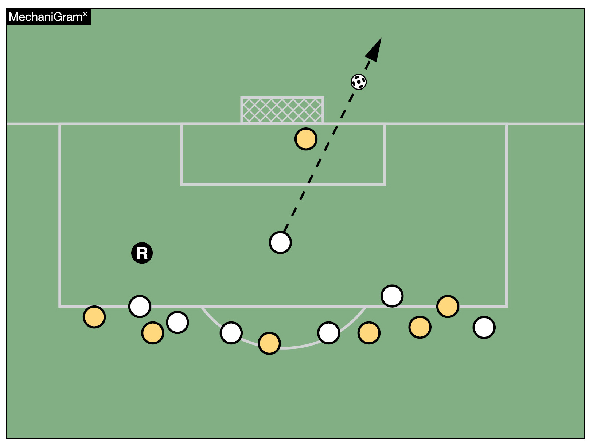
PENALTY KICK
RULE 14-1-2 – ENCROACHMENT
Encroachment is penalized only if the offense has a clear impact on the penalty kick.
If players from either team enter the penalty area or arc early but have no effect on the kicker, goalkeeper, or the immediate play, officials should allow the result of the kick to stand without penalty.
No Impact
Notes:
The mechanigram shows the ball going wide while both teams encroach with no impact. Restart with a goal kick.
Rationale:
The rewrite ensures that encroachment is now only penalized if the offense has a clear impact on the penalty kick. Goalkeepers will now receive a warning for a first offense rather than an immediate caution, acknowledging that such infractions often stem from mis-anticipation. Regarding the kicker, the revisions continue to allow for deceptive movements and stutter-stepping during the run-up; however, the change strictly prohibits feinting once the approach to the ball is completed. Finally, in rare instances where both the kicker and goalkeeper offend simultaneously, the kicker is penalized, as their illegal feinting is typically the catalyst for the goalkeeper’s infraction. The penalty chart is also updated and reformatted for clarity.

Slide 27
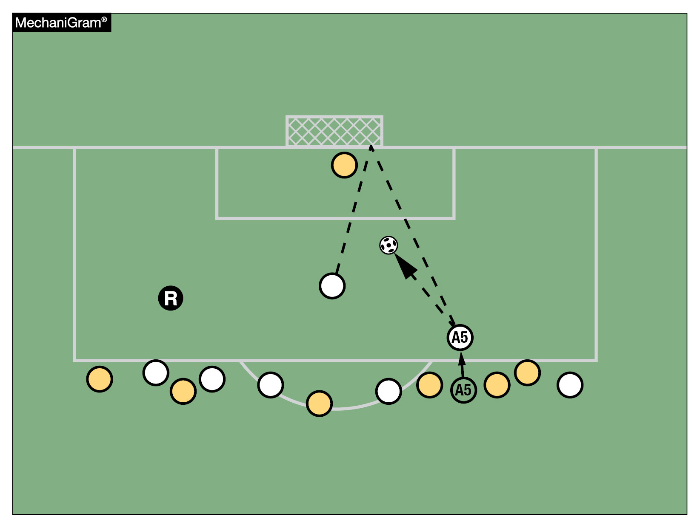
RULE 14 -1-2
Encroaching attacker A5 impacts the play.
Penalty: The defending team is awarded an indirect free kick from where A5 kicked the ball.
Impact
Notes:
In this mechanigram attacker A5 entered the penalty area before the ball was kicked and collected the ball from the rebound off the crossbar. This is an example where A5’s encroachment offense has impact on the penalty kick and thus results in an indirect free kick (IDFK) for the defending team located from where A5 touched the ball.

Slide 28
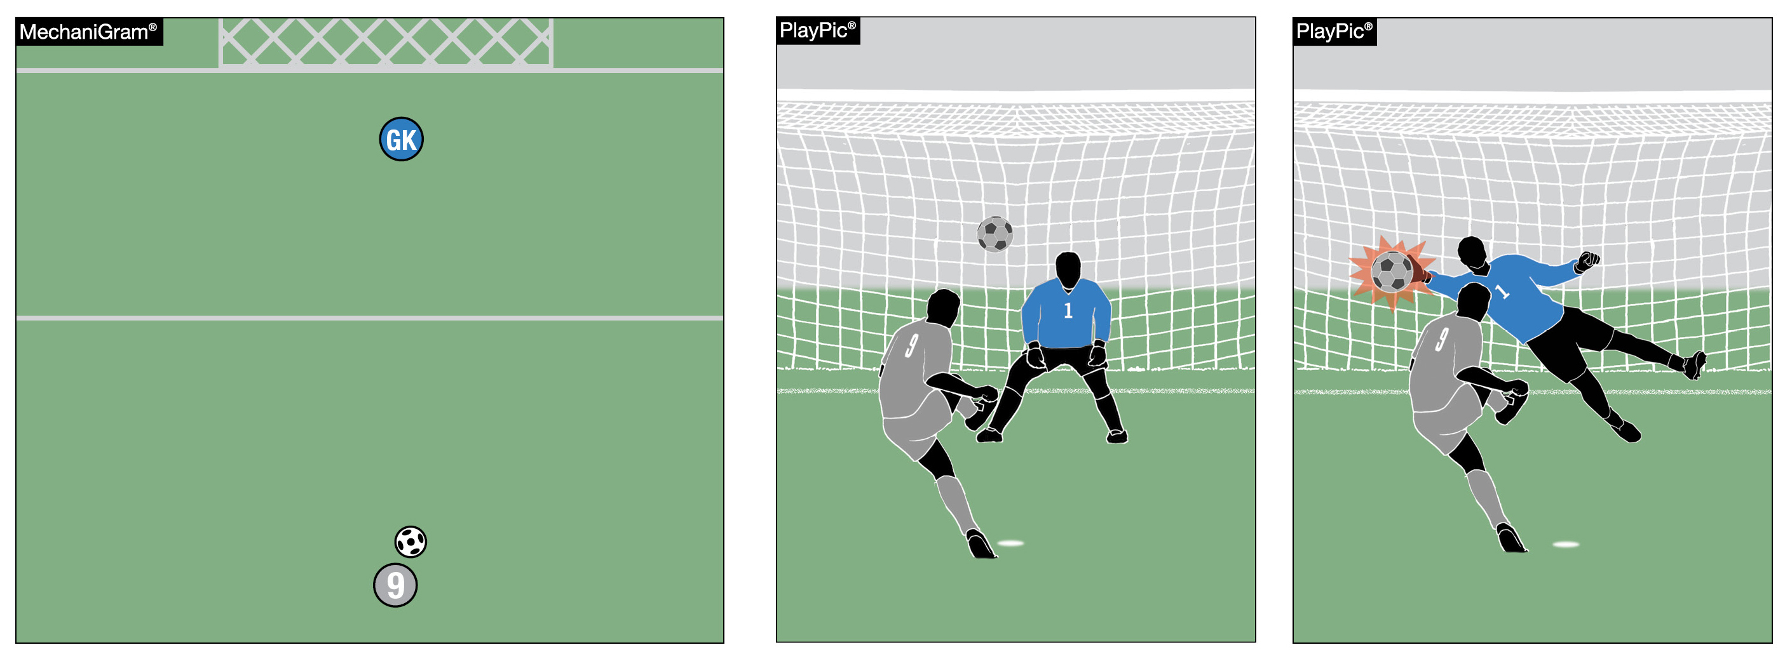
PENALTY KICK
RULE 14-1-3 – GOALKEEPER ENCROACHMENT
Goalkeepers will now receive a warning for a first offense rather than an immediate caution.
Cautions are reserved for subsequent infractions.
Notes:
Rationale: This change acknowledges that when a goalkeeper encroaches these infractions often stem from mis-anticipation and doesn’t over penalize the goalkeeper.
This Mechanigram and PlayPics show the goalkeeper encroaching before the kick is taken. Since the goalkeeper made a save and the ball did not enter the goal, their offense is penalized, and the penalty kick is retaken.

Slide 29
PENALTY KICK
RULE 14 – KICKER FEINTING
Deceptive movements and stutter-stepping by the kicker during the run-up continue to be allowed.
However, feinting (or pretending to kick the ball) once the approach to the ball is completed is strictly prohibited.
This is an act of unsporting conduct that shall be cautioned and is enforced on the first and every subsequent occurrence.

Slide 30
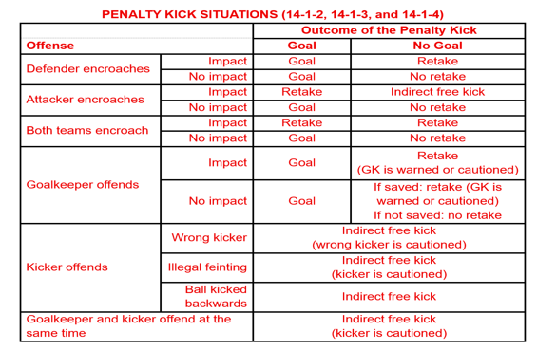
PENALTY KICK
RULE 14 Penalty Chart
Notes:
Rationale: The penalty chart has also been updated and reformatted for clarity and mirrors the rules changes in this rule.

Slide 31
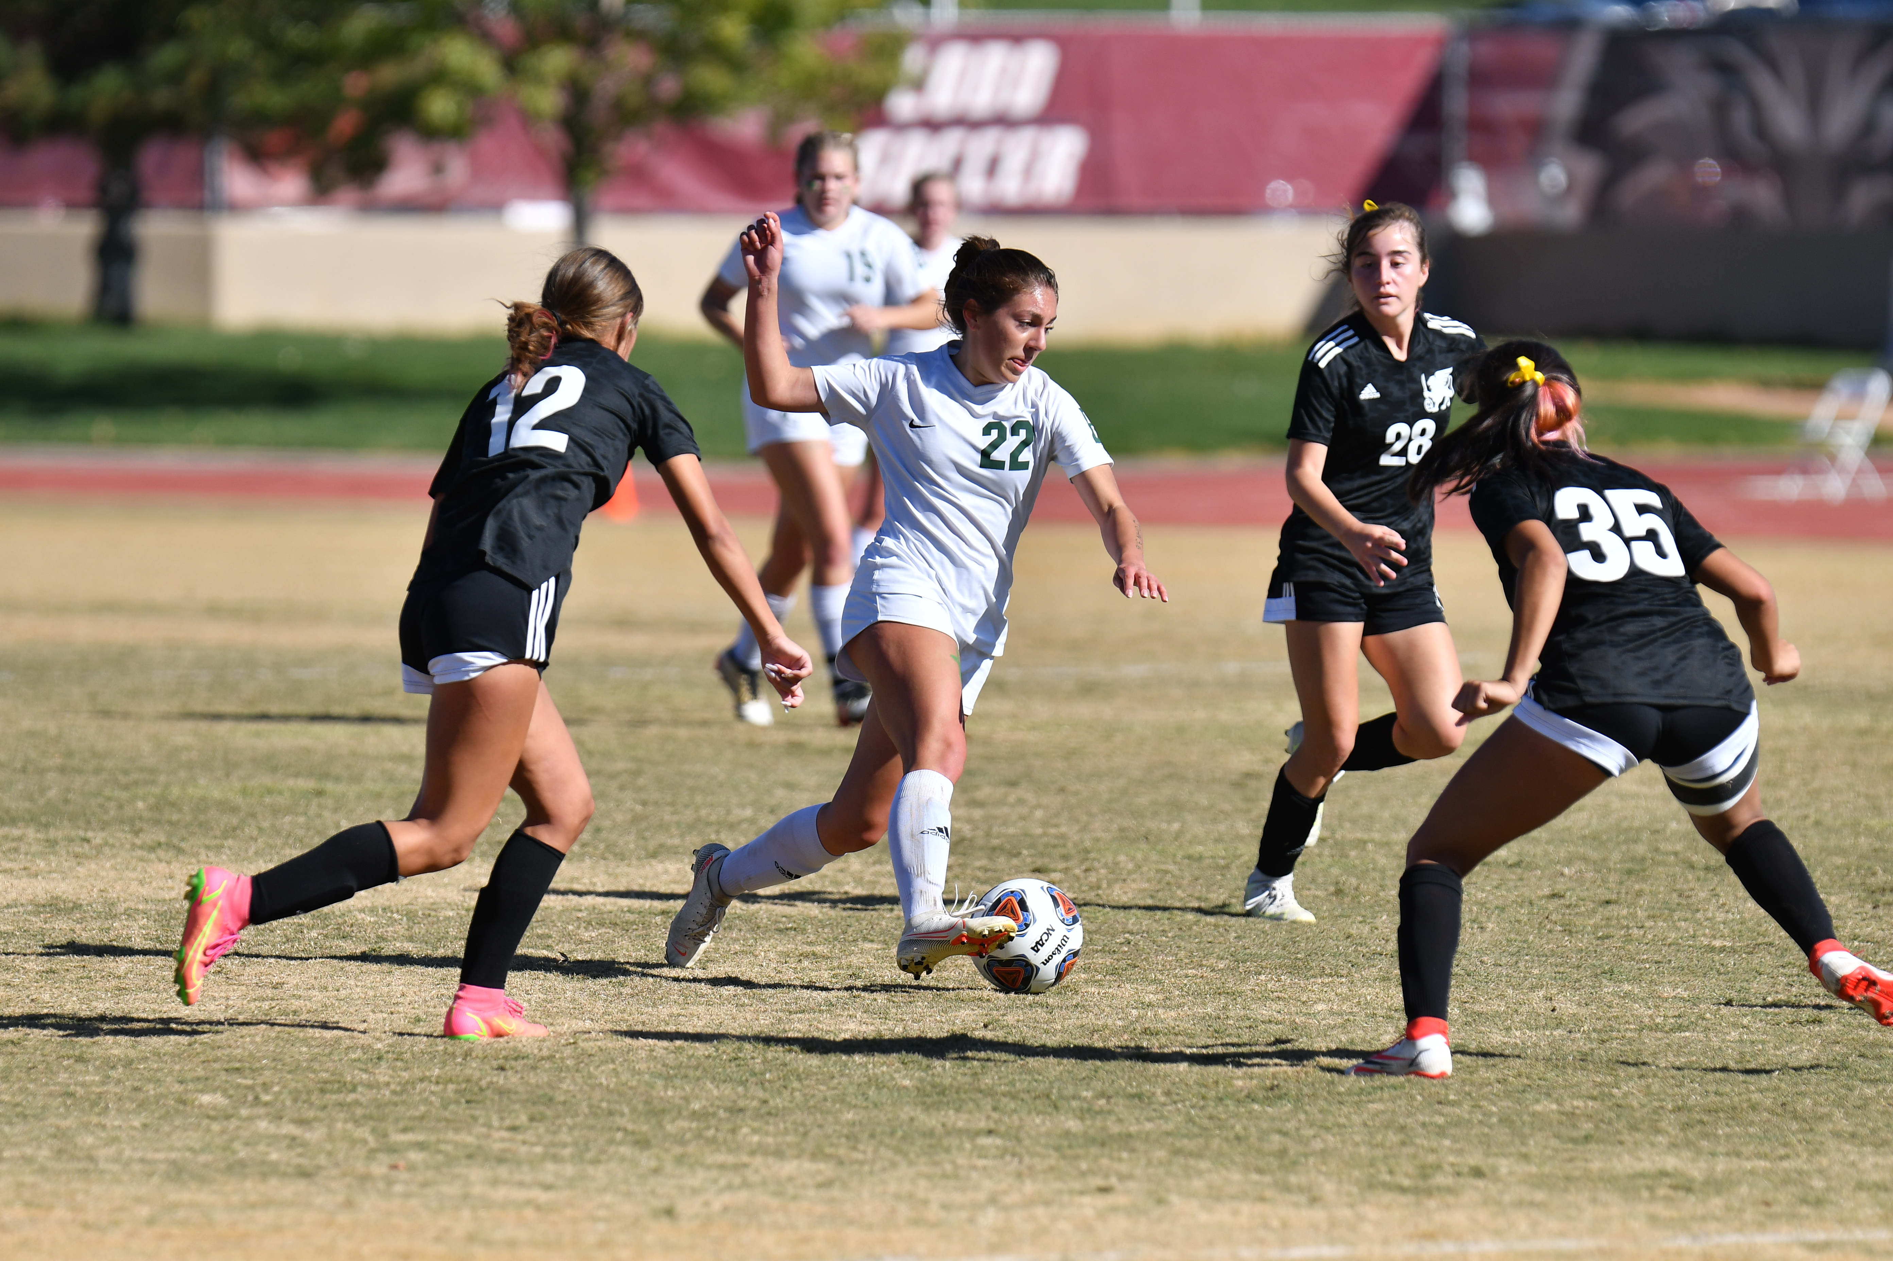
2026-27 NFHS Soccer Editorial Changes

Slide 32
PLAYER EQUIPMENT
RULE 4-1-2
All jerseys, including the goalkeeper's jersey, shall be numbered with a different, unique Arabic number.
If a visible number is worn on the uniform bottom, it shall be the same number as on the uniform top.
Notes:
Rationale: Clarifies different means unique and all rules regarding numbers into the same article.

Slide 33
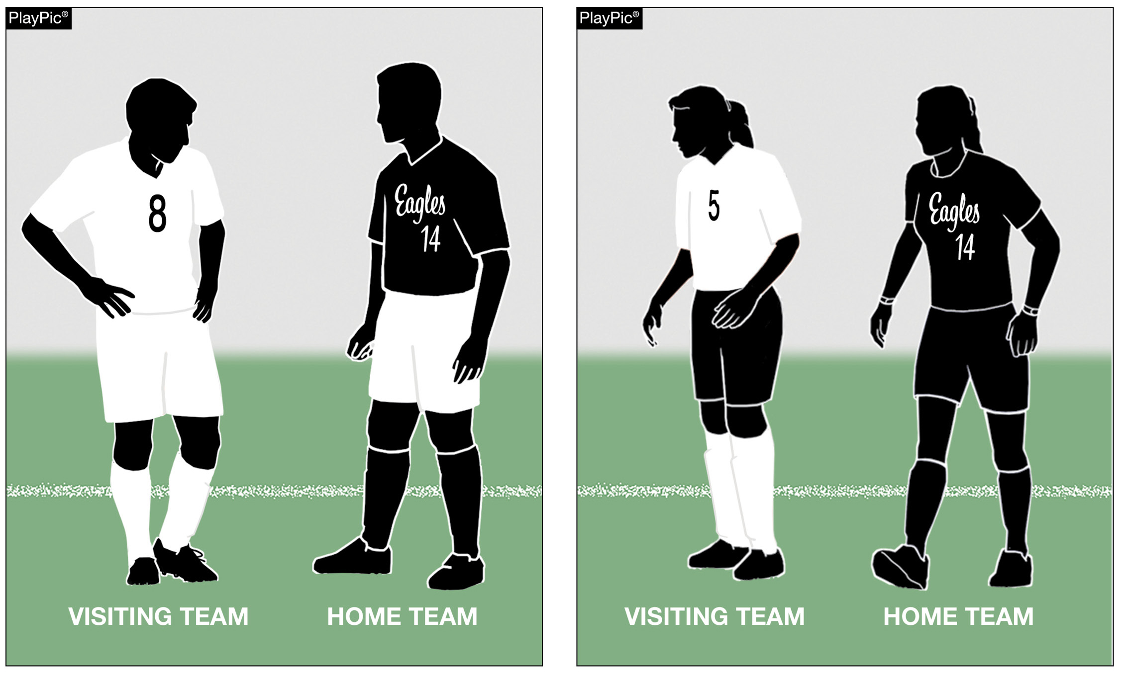
PLAYER EQUIPMENT
RULE 4-3-3
Both teams may wear shorts of a similar color.
Notes:
Rationale: The addition of the language makes it clear that both teams may wear the same color of shorts provided the jerseys and socks are different colors.
The away team is not required to wear white shorts.

Slide 34
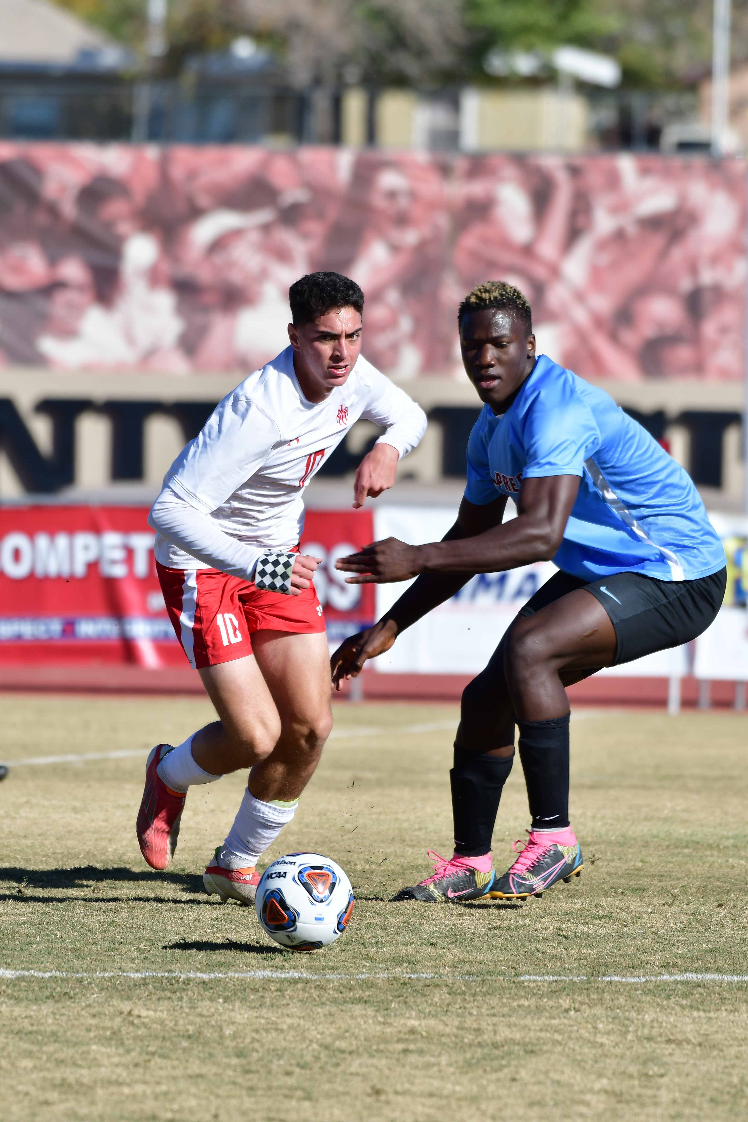
2026-27 NFHS Soccer Points of Emphasis

Slide 35
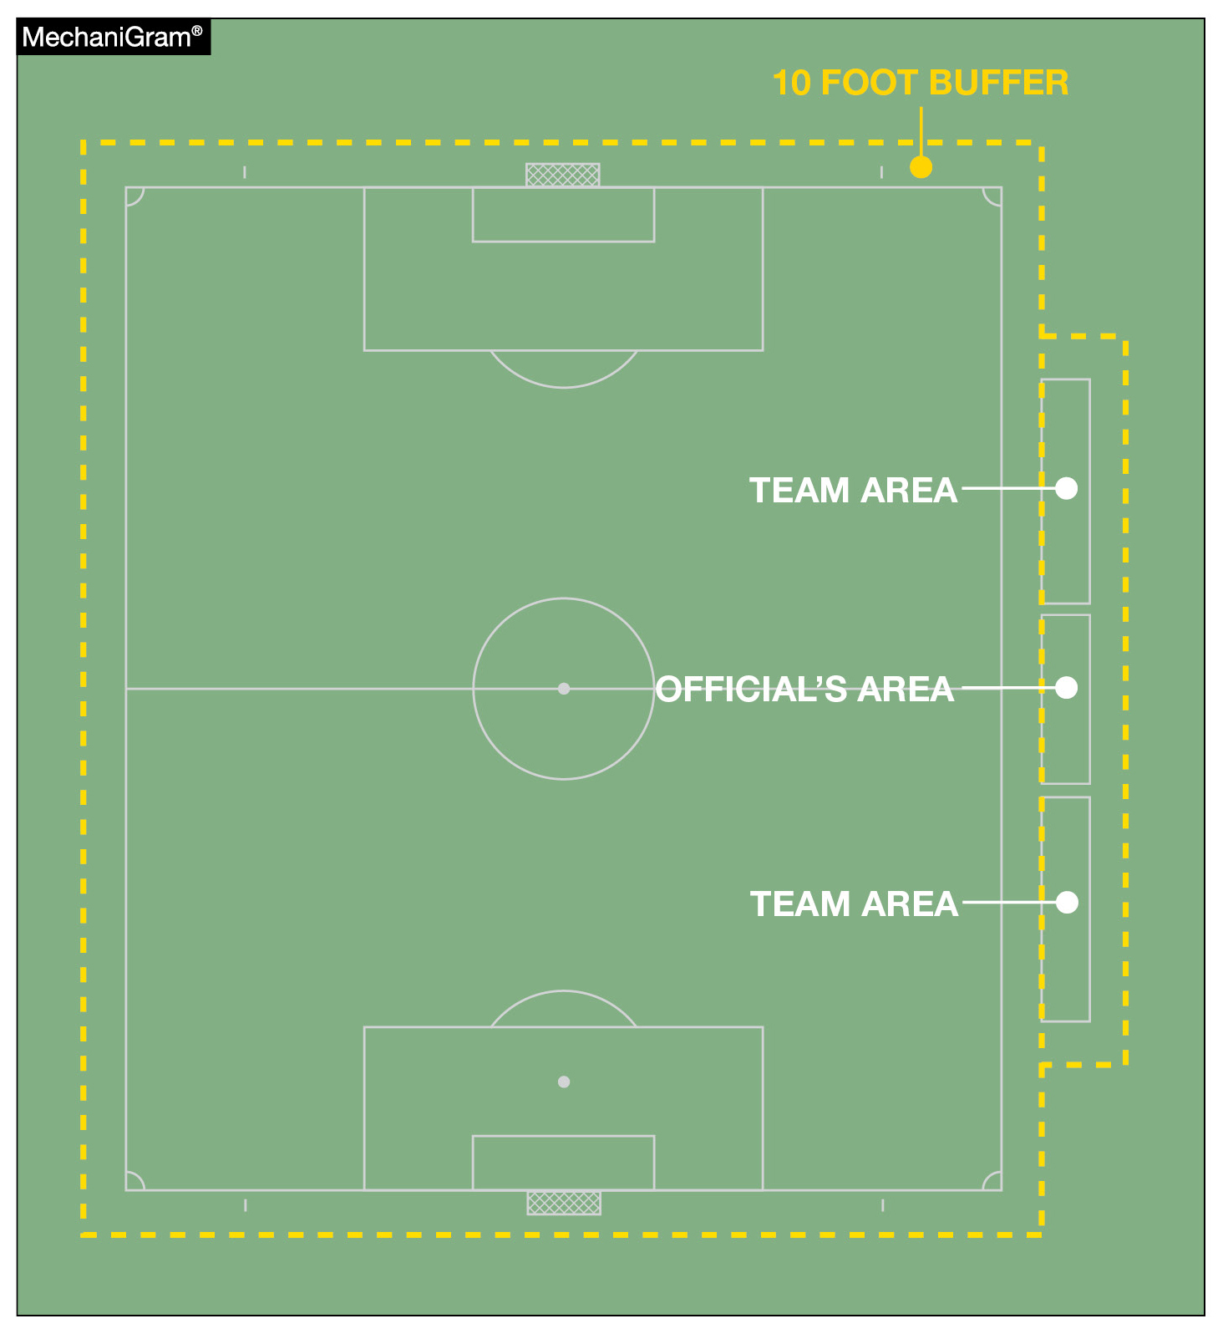
PROPERLY MARKED FIELDS
Administrators, coaches, and officials must prioritize proper marking of team areas and the maintenance of the 10-foot buffer around the field boundary lines.
Team areas extend 10 yards from each side of the halfway line for a total length of 20 yards, set back 10 feet from the touchline.
Team areas must be clearly designated and marked by a solid line. When markings are missing, officials should work with administrators or coaches to place cones as temporary boundaries.
Any violations of Rule 1-5-3 must be reported to the state association.
Notes:
Not drawn to scale.

Slide 36

NFHS AUTHENTICATING
MARK ON GAME BALLS
The NFHS Authenticating Mark ensures easy identification of balls used in interscholastic competitions. All such balls are required to display the NFHS Authenticating Mark.
This mark helps promote a level playing field by ensuring consistency in equipment and clearly communicates that standards are being met.
Administrators and coaches play a pivotal role in making sure all balls meet specifications through consistent reinforcement during pre-competition meetings.
Game officials must remain vigilant and report any non-compliant balls to the state association office.
Notes:
A current list of NFHS authenticated products can be found at www.nfhs.org, Resources, Authenticating Mark.

Slide 37
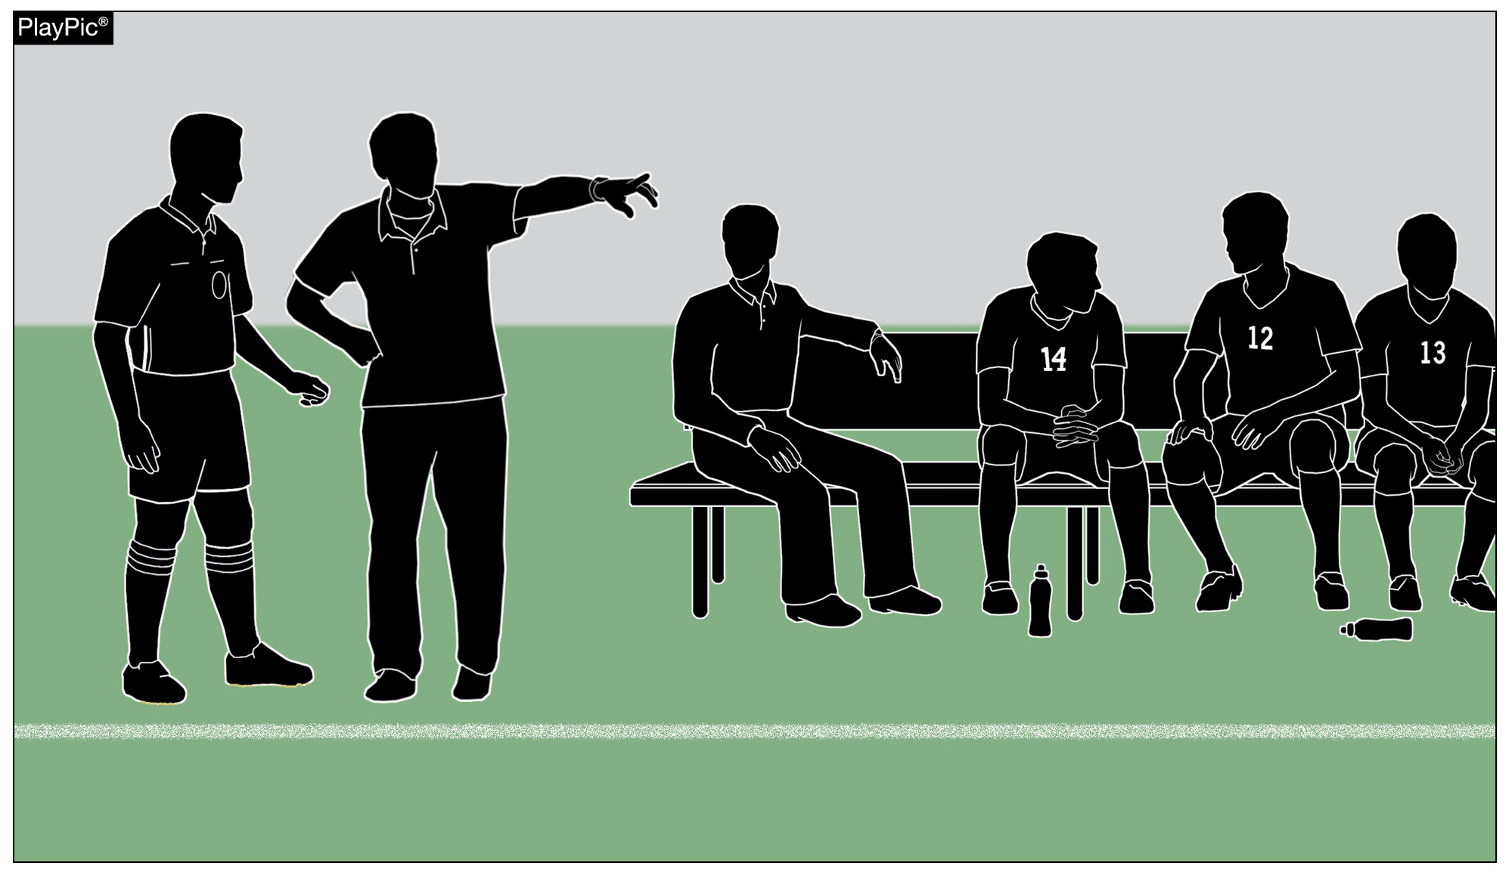
SHARED PROFESSIONALISM
AND BENCH ACCOUNTABILITY
High school soccer serves as an extension of the classroom, requiring both officials and coaches to uphold the highest standards of composure and integrity.
Professional communication should remain non-threatening and conversational. Raising one’s voice, displaying frustrations or acting in a provocative manner only escalates conflict.

Slide 38
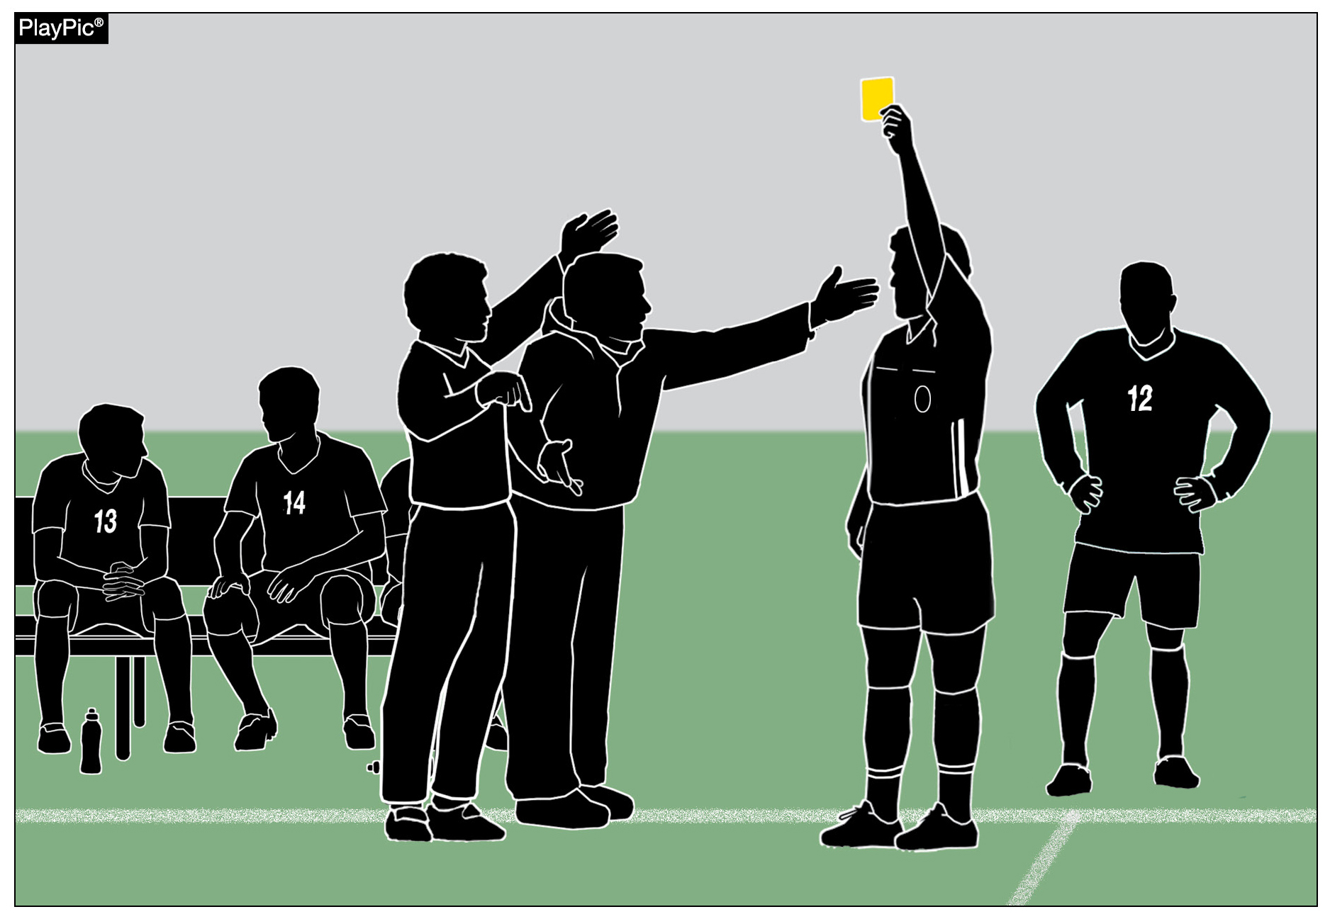
SHARED PROFESSIONALISM
AND BENCH ACCOUNTABILITY
When a caution or ejection is issued, officials advise the head coach using appropriate rulebook language. Both parties share responsibility for ensuring communication remains professional.
Any dissent or inappropriate conduct should be addressed firmly and professionally. Coaches are accountable for their behavior and must model emotional control and sportsmanship.

Slide 39
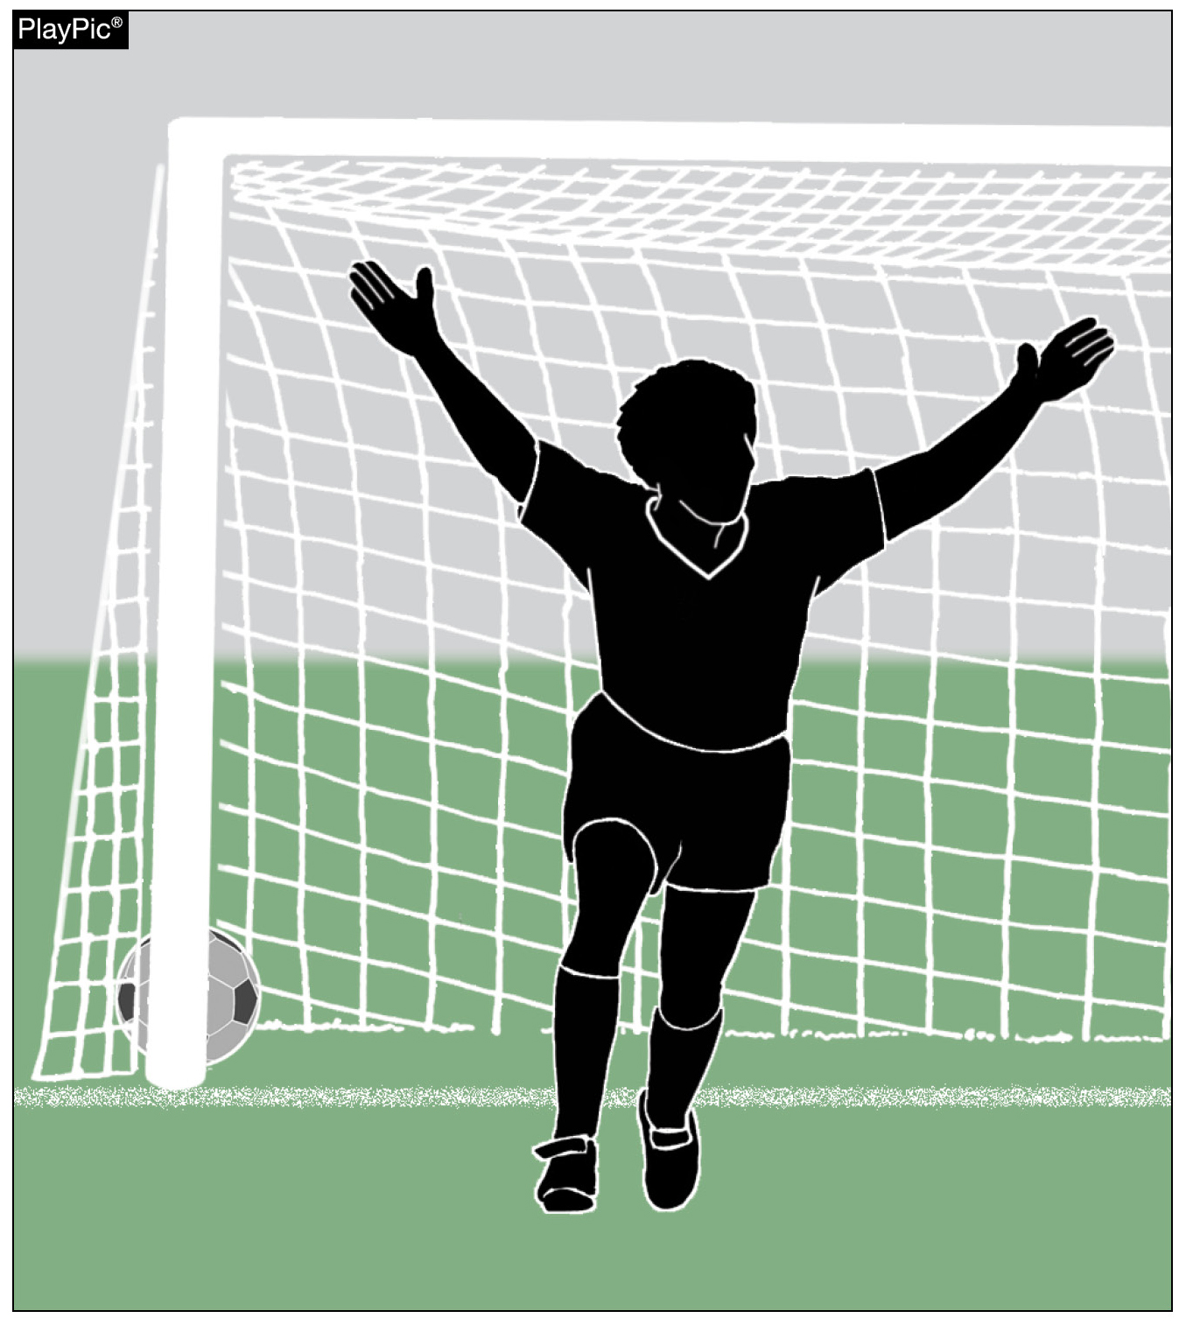
MANAGING GOAL
CELEBRATIONS
Celebrating after scoring a goal is an integral part of soccer. Reacting with joy is permissible provided it is not excessive and not accompanied by taunting.
Players are allowed to celebrate and may leave the field momentarily, provided they make a prompt return to the playing field. Rehearsed or choreographed celebrations should be discouraged.

Slide 40
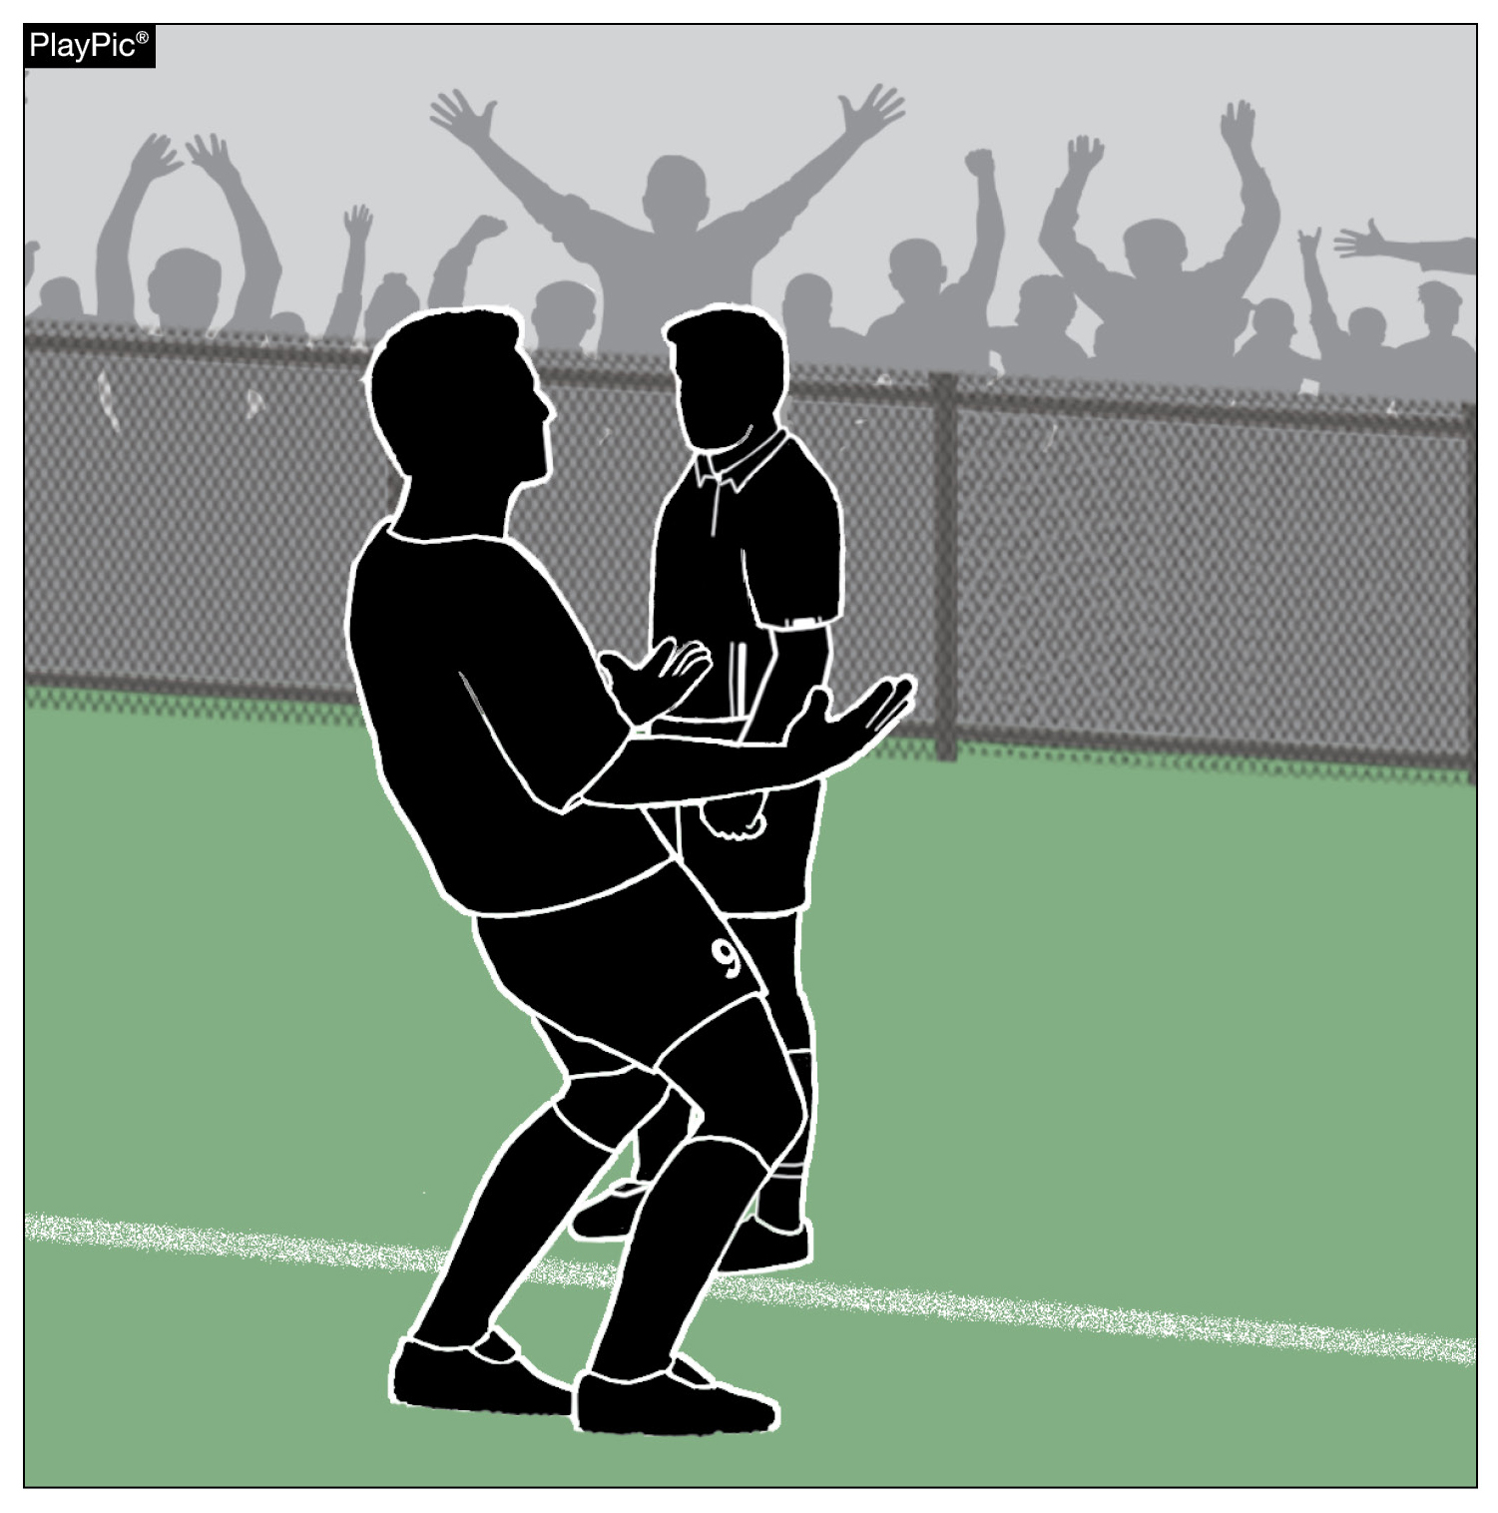
MANAGING GOAL
CELEBRATIONS
The line between allowable celebration and misconduct is crossed when a player or team prevents a timely restart by delaying excessively or by taunting opponents or fans.
Examples of misconduct include jumping over barriers, climbing fences, or removing one’s jersey. Any act that prohibits a timely restart is unsporting conduct and requires a caution.

Slide 41
PENALTY KICK OFFENSES
AND THE CONCEPT OF IMPACT
Encroachment during a penalty kick is only penalized if the offense has a clear impact on the play.
Encroachment by the defending team is never penalized if the goal is scored. If the kick is missed or saved and the defense encroached with impact, the kick is retaken.
Goalkeepers who encroach and impact the kicker shall receive a warning for the first offense, with cautions reserved for subsequent infractions.
While kickers are permitted stutter-steps during the run-up, feinting once the approach is complete is unsporting conduct that shall be cautioned on every occurrence.

Slide 42
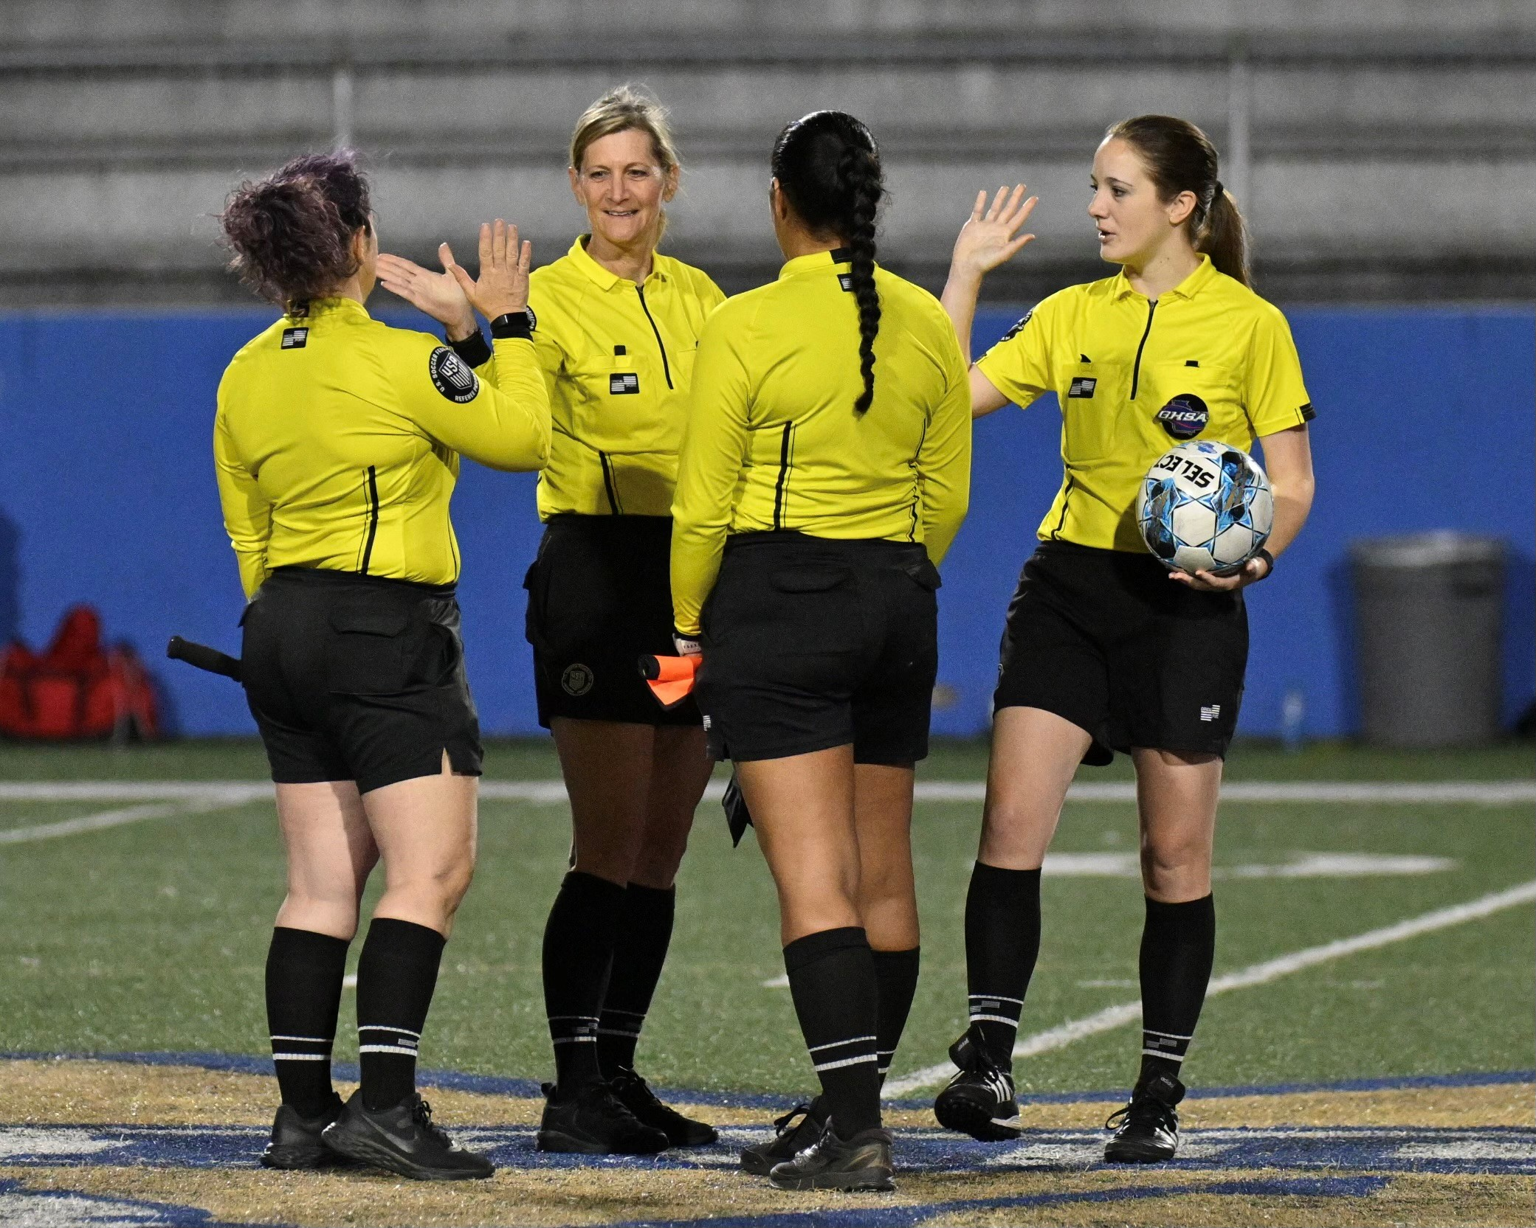
NFHS Officials Education

Slide 43

All Things Officiating in One Place!
The all-in-one, cloud-based NFHS Center for Officials Services (COS) connects everyone associated with officiating. The COS handles registration, assignments, testing, payments, and a host of other features and integrations that consolidate all officiating needs into a single, modern solution. Free to all NFHS state associations, local associations, and assigner groups.
20+
Member States
300,000+
Officials
7,000+
Schools
Notes:
The all-in-one, cloud-based NFHS Center for Officials Services (COS) connects everyone associated with officiating. The COS handles registration, assignments, testing, payments, and a host of other features and integrations that consolidate all officiating needs into a single, modern solution. Free to all NFHS state associations, local associations, and assigner groups.

Slide 44
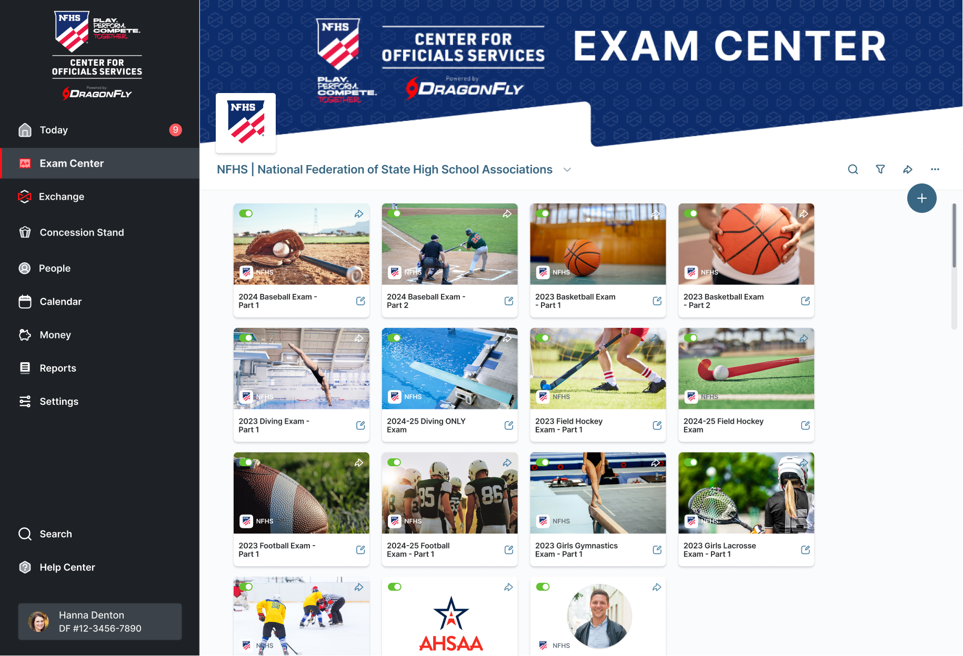
Improved Exam Center

Slide 45


The National Leader
100+ Online Courses
75+ Available at No Cost!
Active in All 50 States
Valuable Professional Development
Earn Completion Certificates
Earn National Credentials
Earn Badges
www.nfhslearn.com
Notes:
The NFHS Learning Center is the home to more than 100 online professional development courses for everyone within the interscholastic community - coaches, students, officials, parents, administrators, and individuals within performing arts programs. More than 75 courses are available for free.
The NFHS is an Accredited Institution and has delivered more than 15 million courses on its NFHS Learning Center platform since its inception in 2007. In receiving national accreditation by Cognia, the NFHS has upheld itself to rigorous standards that focus on productive learning environments, equitable resource allocation that meet the needs of learners, and effective leadership.

Slide 46
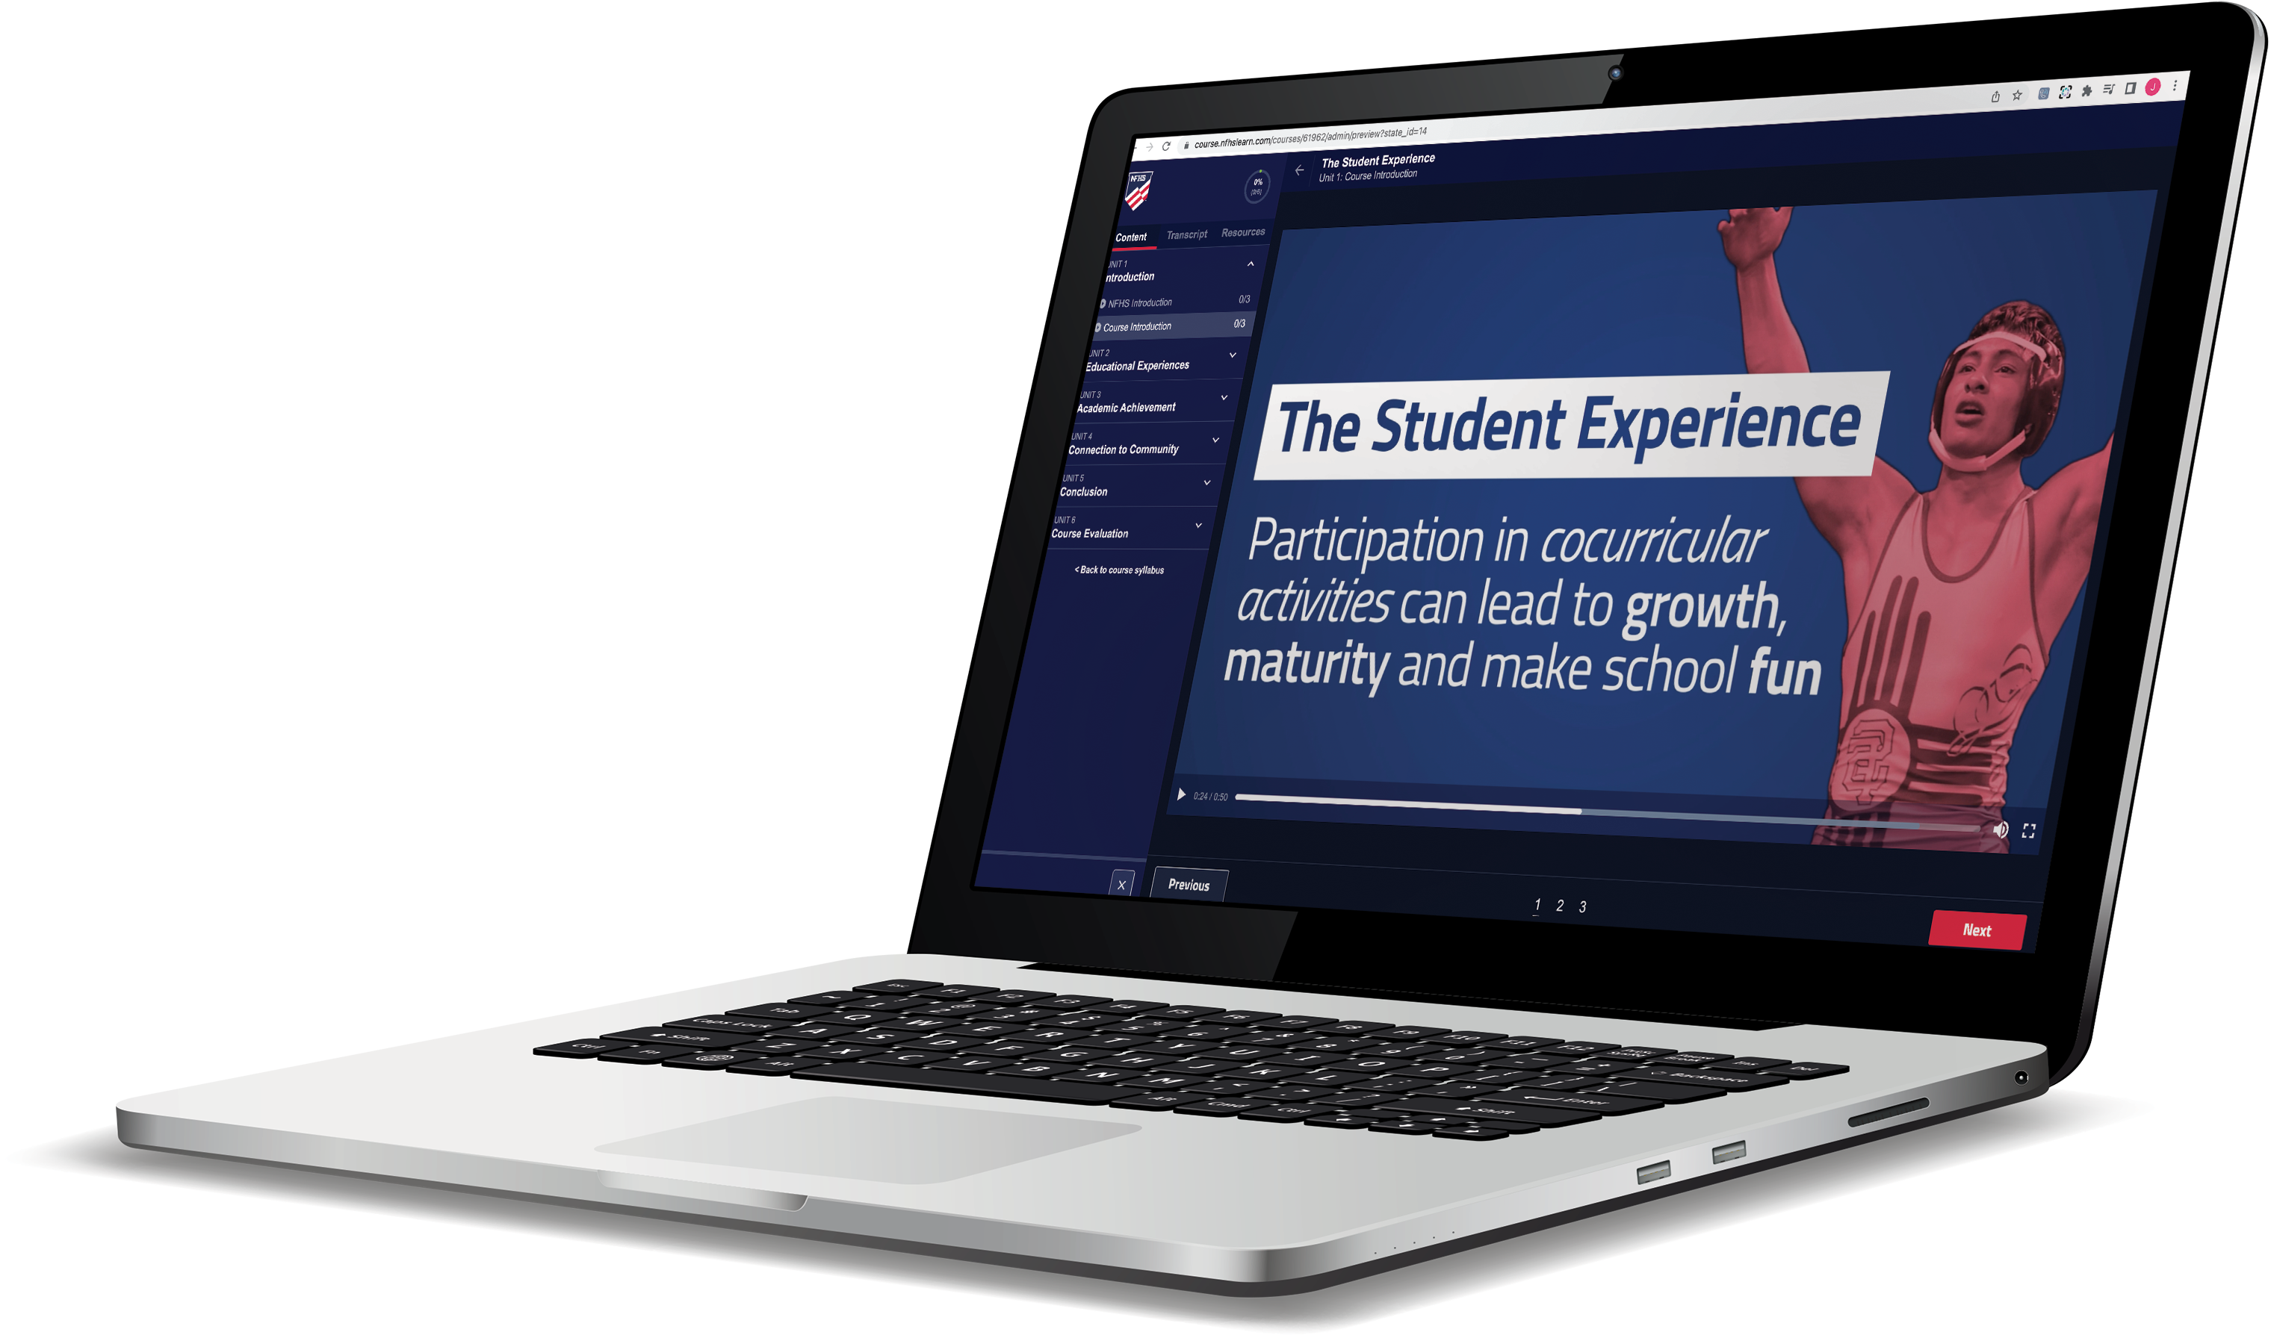
Over 29 million courses delivered!
Concussion in Sports – 9.2M+
Heat Illness Prevention – 3.6M+
Sudden Cardiac Arrest – 3.9M+
Concussion for Students – 2.1M+
The Collapsed Student (2020) – 108,000+
CPR & AED Training (2023) – 55,500+
Sportsmanship – 1.7M+
Fundamentals of Coaching – 1.1M+
First Aid, Health and Safety – 505,000+
Bullying, Hazing and Inappropriate Behaviors – 658,000+
Student Mental Health and Suicide Prevention – 460,000+
Coaching Mental Wellness (2025) – 37,750+
Emergency Action Planning for Afterschool Programs (2025) – 14,600+

Slide 47
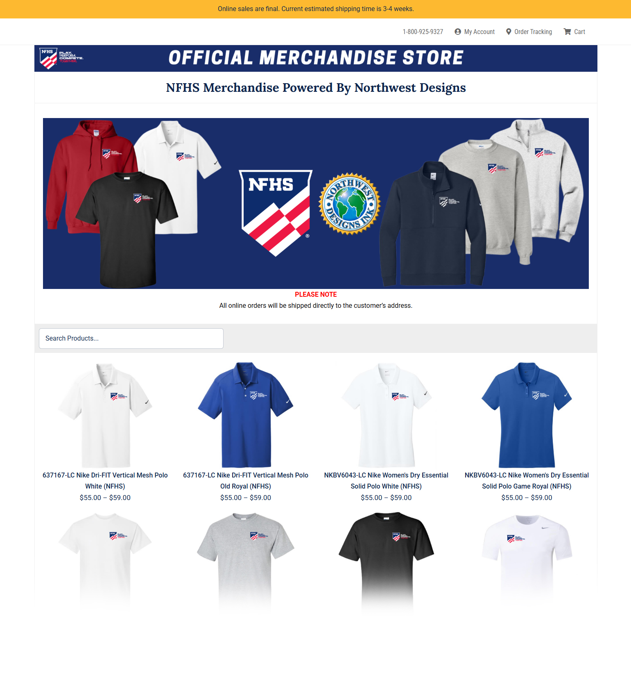
NFHS Store
We’re excited to introduce a new NFHS Store, powered by Northwest Designs, making it easier than ever to shop NFHS-branded apparel and have it delivered straight to your home or office. The collection features t-shirts, polos, sweatshirts, and quarter-zips from top brands like Nike and Gildan. We can’t wait to see our membership proudly representing the NFHS brand!
https://online-apparel.com/s/nfhs-merchandise/

Slide 48

NFHS Authentication Mark Update

Slide 49



NFHS Authenticating Mark Update
Specifications
Do not use the NFHS Authenticating Mark without prior written approval from the NFHS
This mark is for use of licensees only.
Minimum size
  Inflatable Balls - 2 ½“ in length (Basketball, Football, Soccer, Volleyball, and Water Polo)
  Non-Inflatable Balls - 1 ¼" in length (Baseball, Field Hockey, Ice Hockey Puck, Lacrosse, and Softball)
  On a ball or puck, the NFHS mark may be smaller than manufacturer’s logo, but should be placed in proximity to the manufacturer’s name for easy identification. Allow enough space around the mark so it can be easily recognized as distinct and separate.
  Reproduce the mark only from the vector artwork provided on Direct Licensing Hub. Do not copy, scan art electronically or use as a template to redraw the symbol.
Note: If sizing or specifications do not work well in your particular design situation, contactK12 Licensing.
Old Logos
Current Logo

Slide 50



Soccer
Old Size
Current Size
1.25”
2.5”
circumference = 27.5”
circumference = 27.5”

Slide 51

NFHS Network
27 Different Sports and Activities.
By 2028, every high school event
in America will be streamed live.
The NFHS Network will be
THE DESTINATION for fans.
OUR NETWORK
www.NFHSnetwork.com
Notes:
The NFHS Network is a website and app where fans can watch live and replay high school sports and activities. It features 27 different sports and activities, and by 2028, every high school event in America will be streamed live—making the NFHS Network THE DESTINATION for fans.

Slide 52

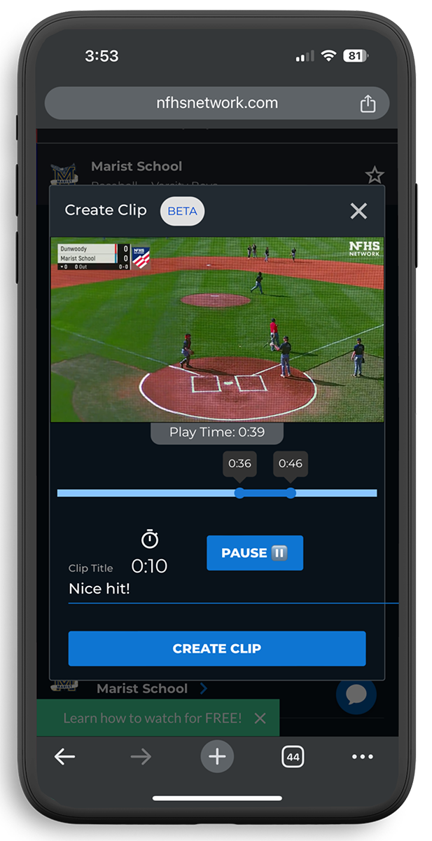
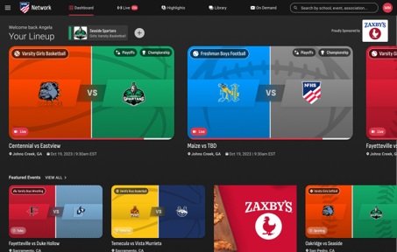
Capture Your Memories –
Clip and Share
Allowing fans to capture and share their favorite moments
Notes:
The NFHS Network will broadcast over 750,000 live events this year. If your school is not a member of the NFHS Network School Broadcast Program, please contact us at Mark.Koski@NFHSnetwork.com

Slide 53
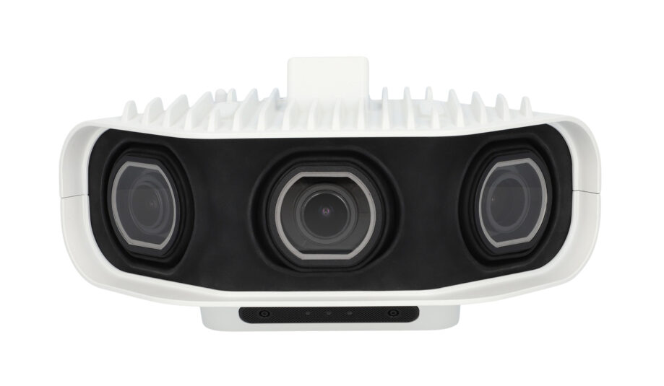


Automated Content Platform: Summary
Live Stream
+
VOD
VOD
Pixellot Camera
Coaching Platform
Game Breakdown
100%
Automated
Score, Team Stats,
Player Stats
Short Form Videos
Notes:
Pixellot captures the event and automatically sends live and VOD content to the NFHS Network.
VOD then flows into MaxPreps Advantage for coaching tools, game breakdowns, and team/player stats.
Content can also support MaxPreps and MaxPreps Sites through highlights and short-form video.
The key value is automation: one capture creates multiple uses across streaming, coaching, stats, and promotion.
This reduces manual work for schools while increasing content, visibility, and engagement.

Slide 54

Notes:
· The NFHS Network is the central platform for the high school fan experience.
· PlayOn, GoFan, NFHS Network, and MaxPreps each support a different part of the ecosystem: streaming, ticketing, content, stats, and school engagement.
· Together, these platforms create a connected experience for fans, families, schools, and communities.
· The goal is simple: make high school events easier to access, easier to follow, and more engaging before, during, and after the game.
· This partnership approach helps expand visibility for education-based athletics while strengthening the overall value of the NFHS Network.
jcochran

Slide 55
Thank You
NFHS.org Phone # 317-972-6900

